Slide 1

Development Tools and Platforms

Slide 2
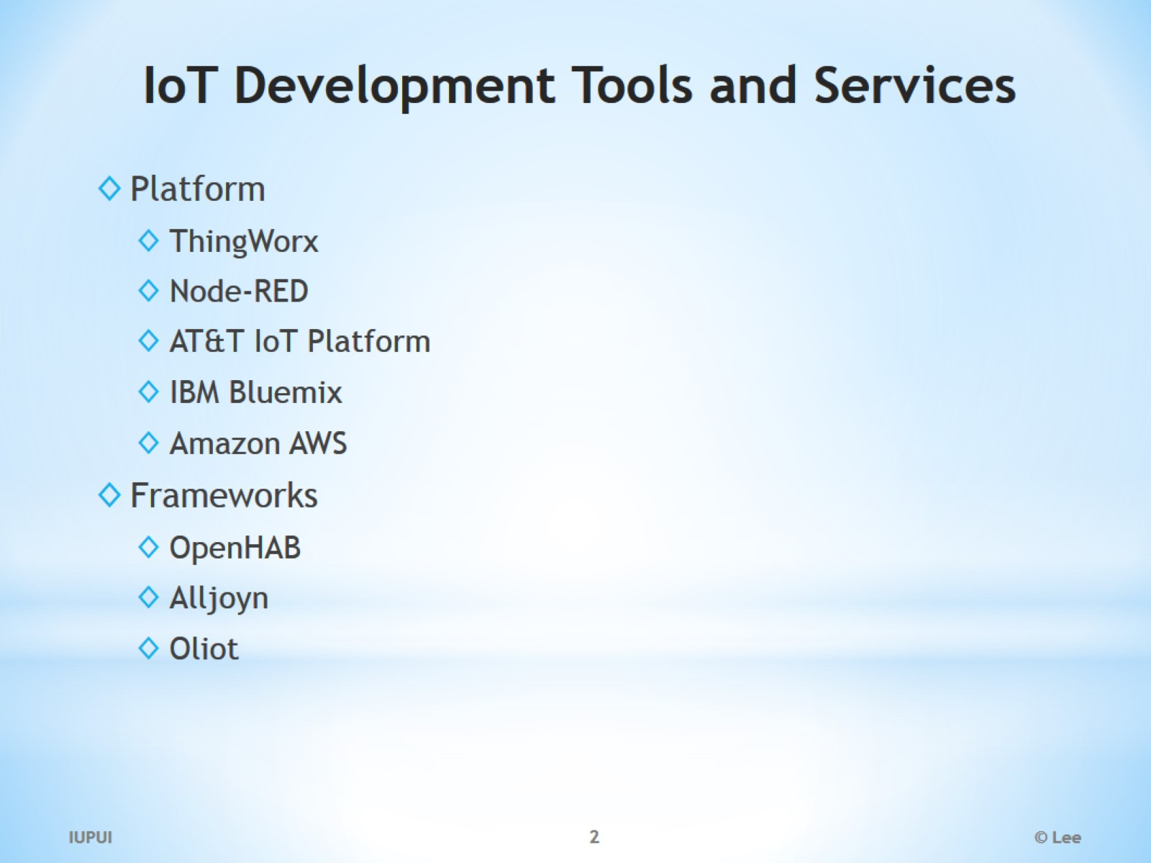
IoT Development Tools and Services

Slide 3
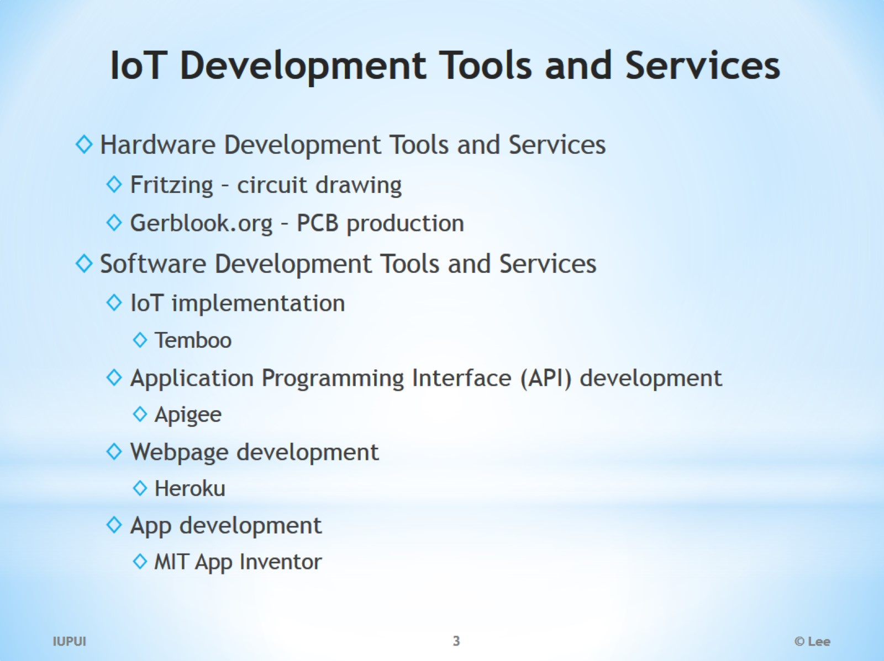
IoT Development Tools and Services

Slide 4
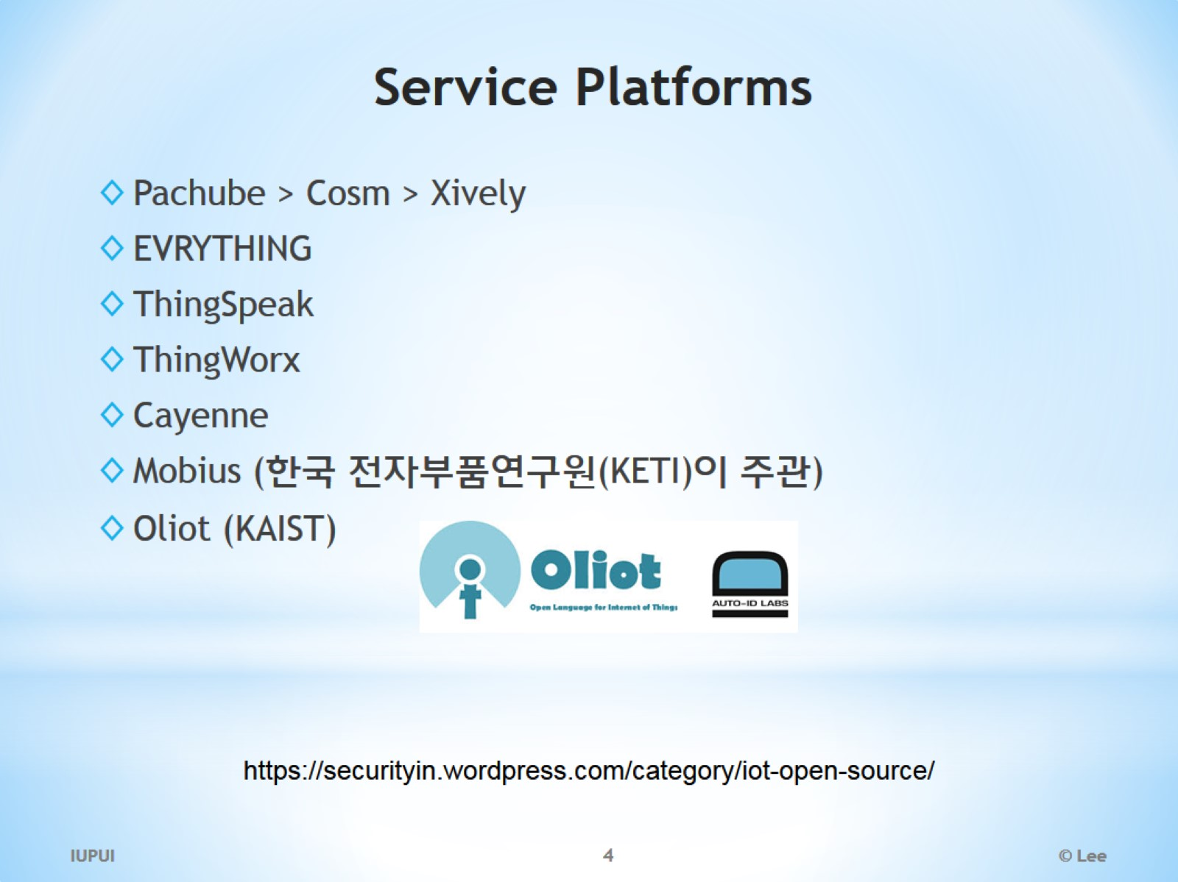
Service Platforms

Slide 5
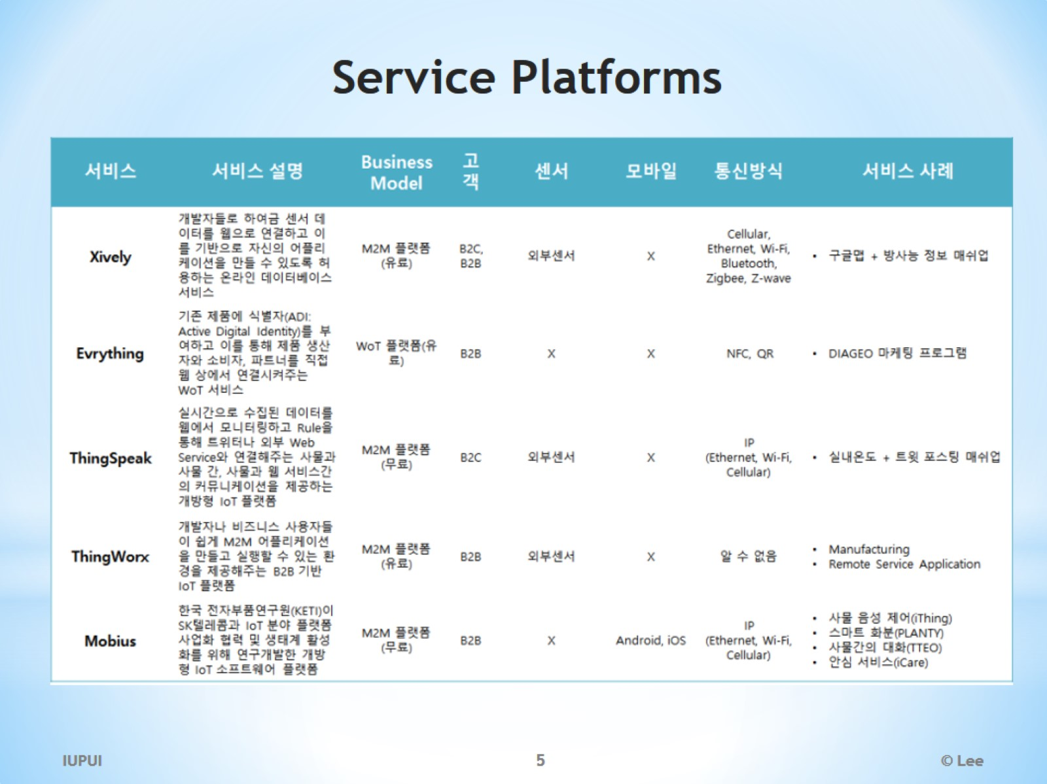
Service Platforms

Slide 6
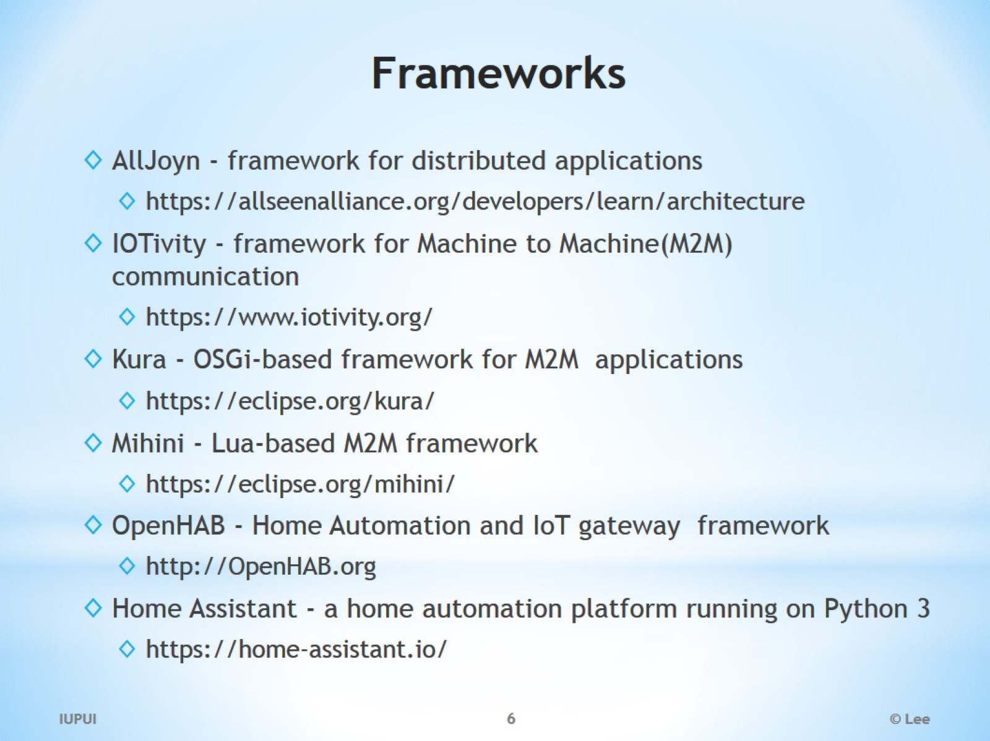
Frameworks

Slide 7
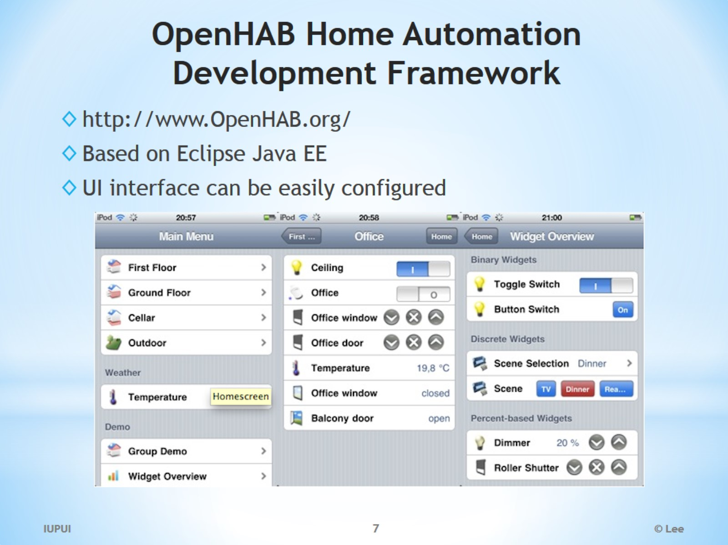
OpenHAB Home Automation Development Framework

Slide 8
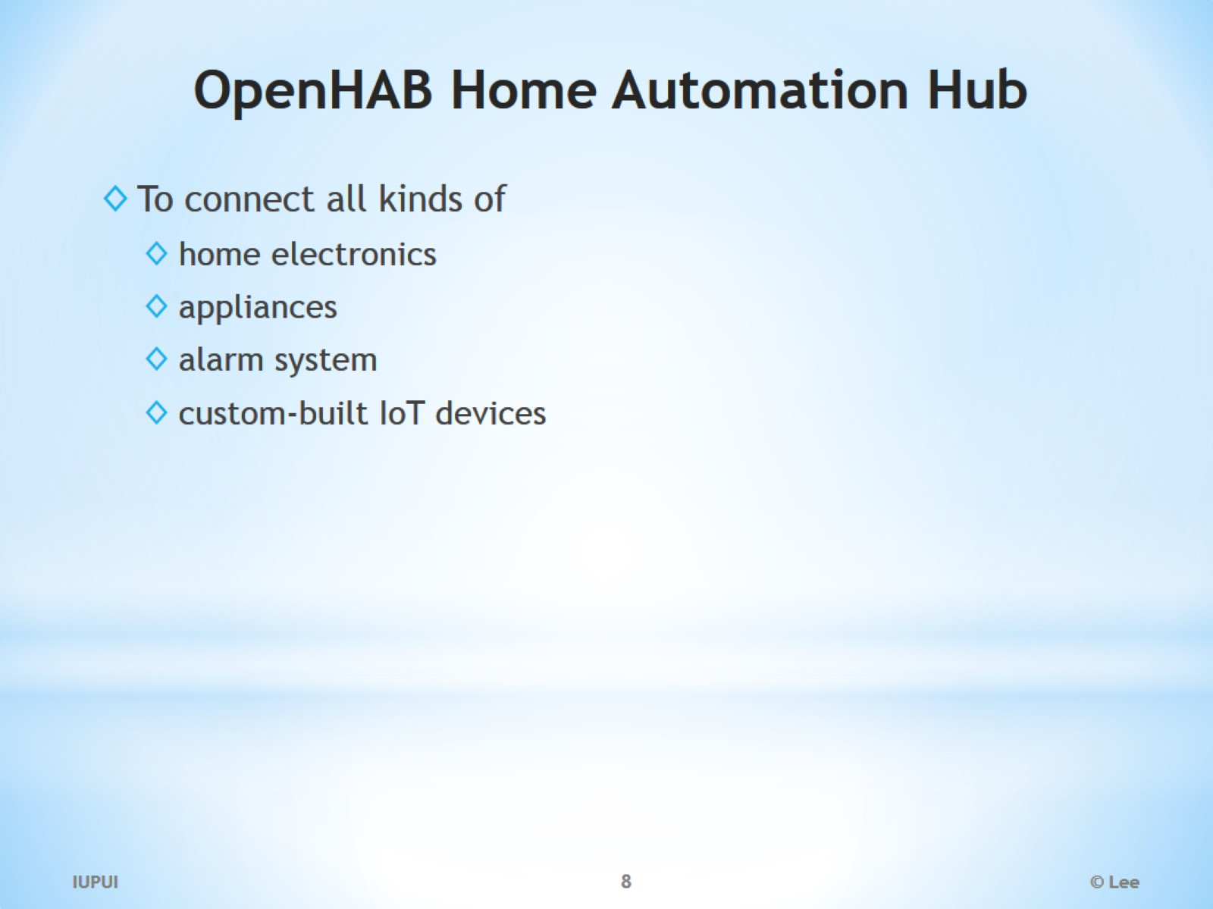
OpenHAB Home Automation Hub

Slide 9
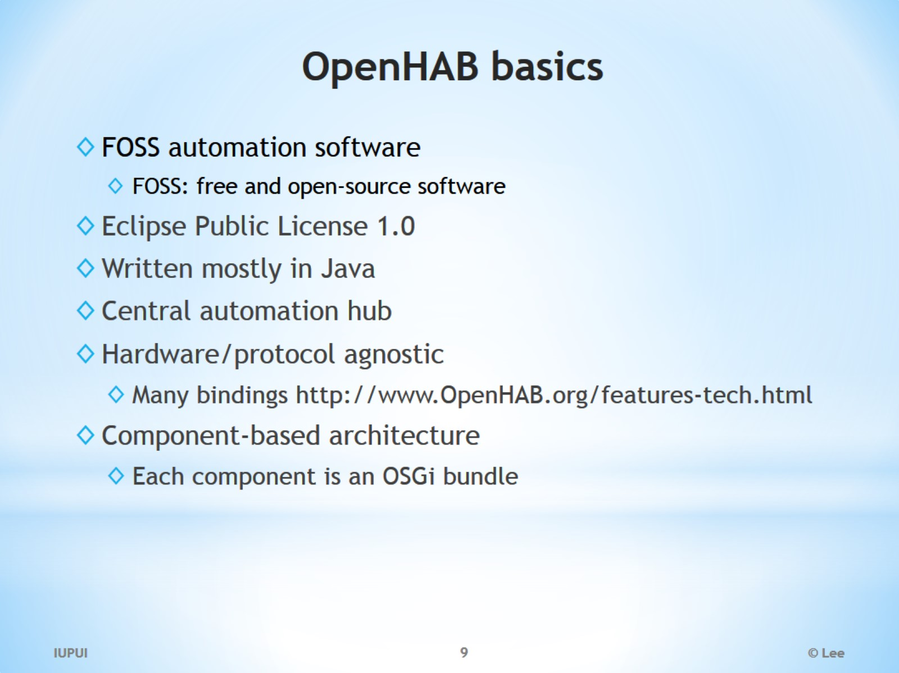
OpenHAB basics

Slide 10
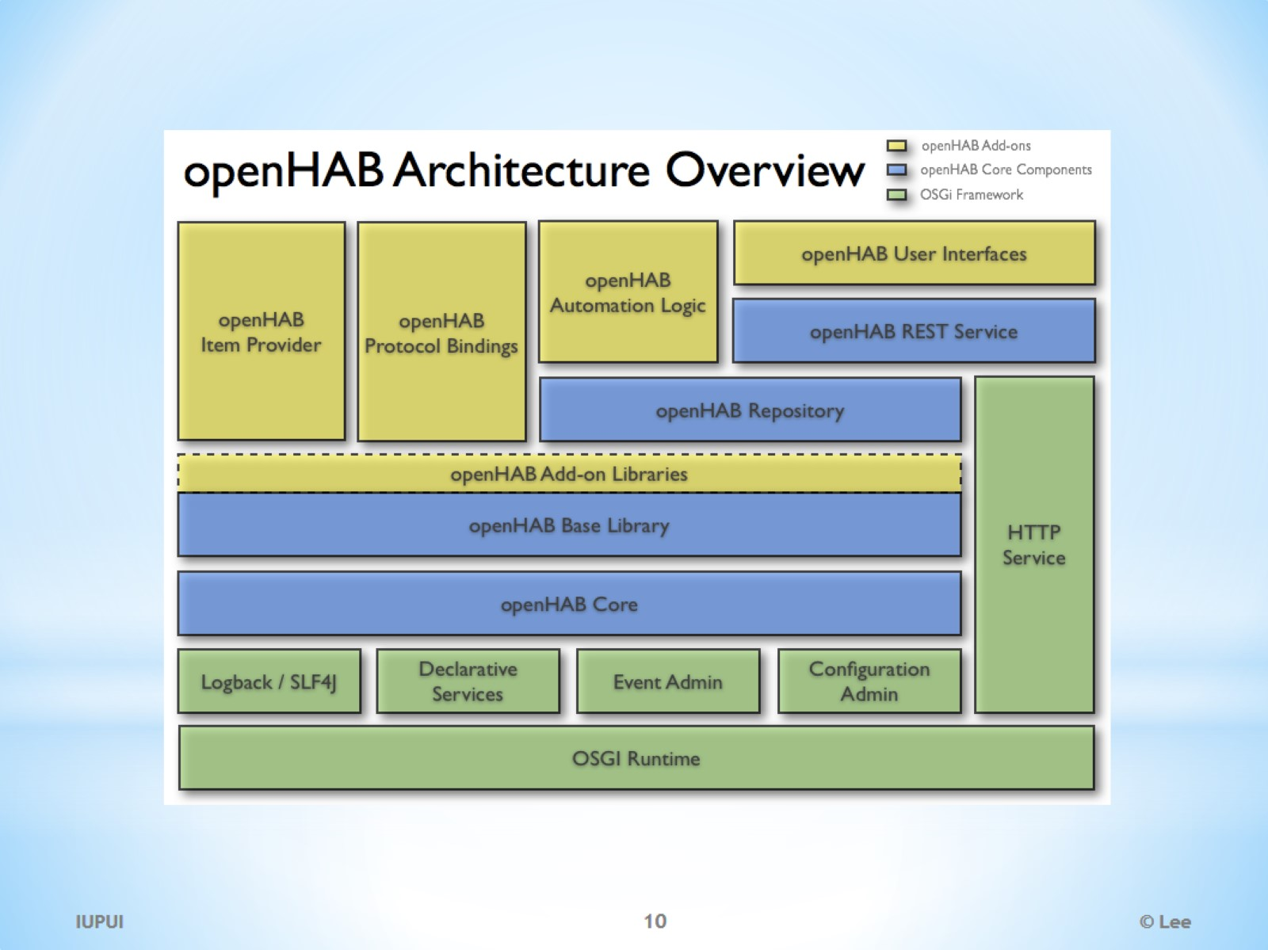

Slide 11
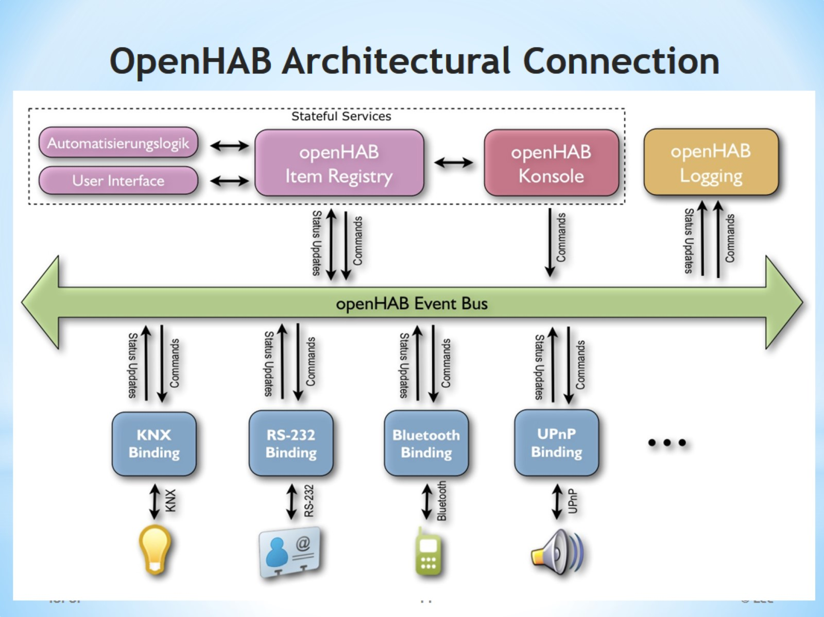
OpenHAB Architectural Connection

Slide 12
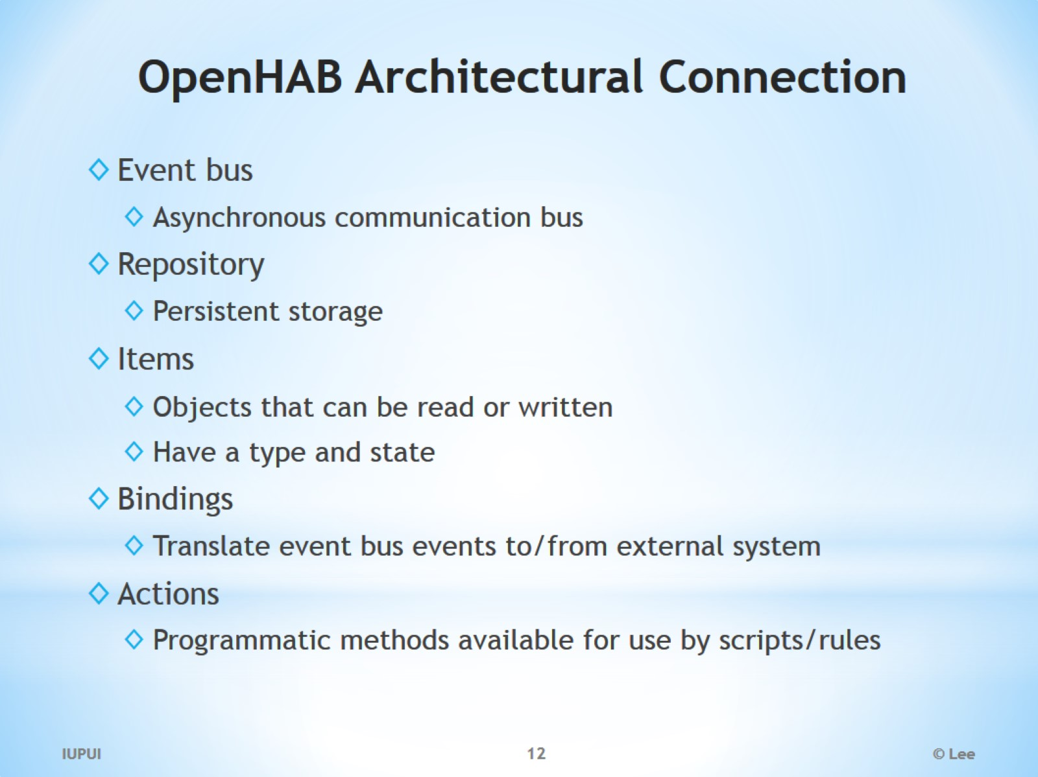
OpenHAB Architectural Connection

Slide 13
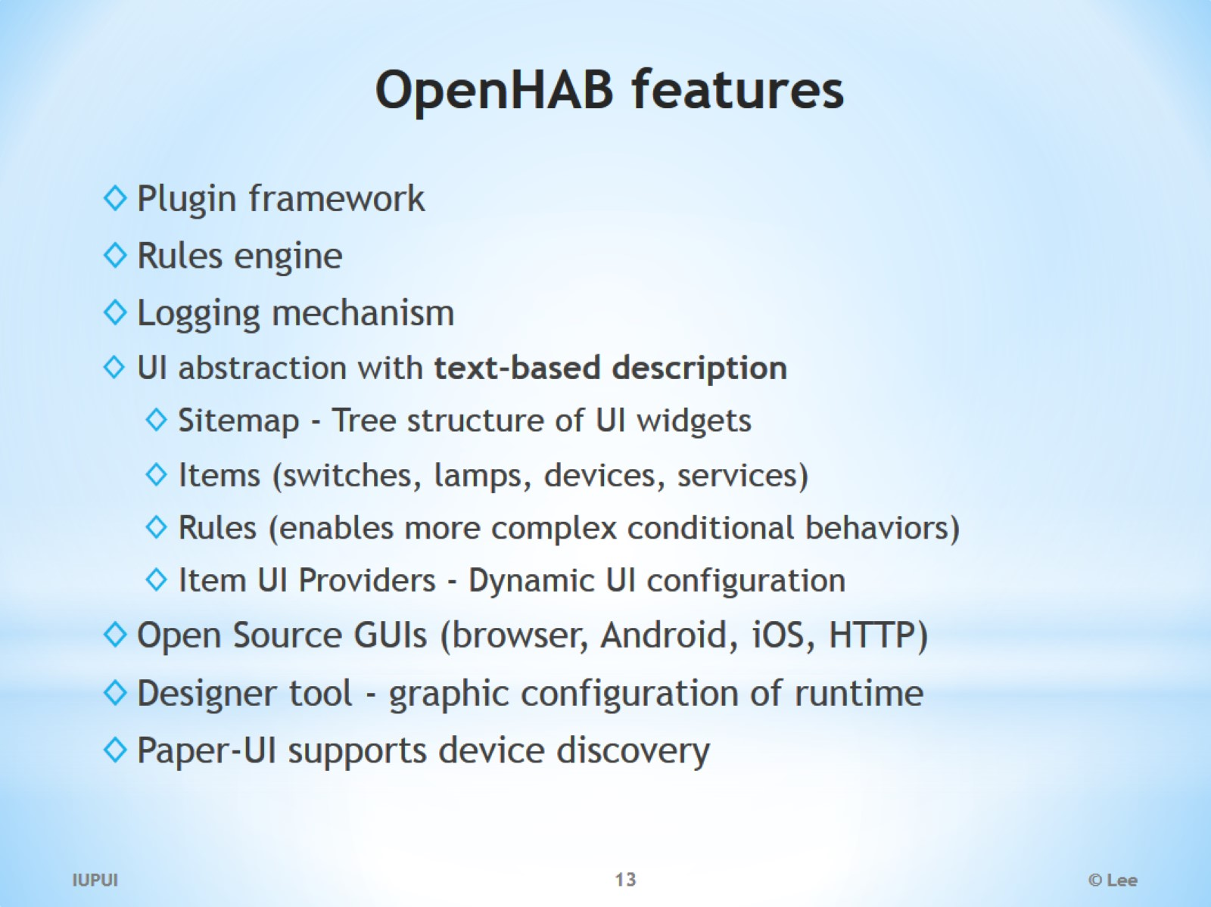
OpenHAB features

Slide 14
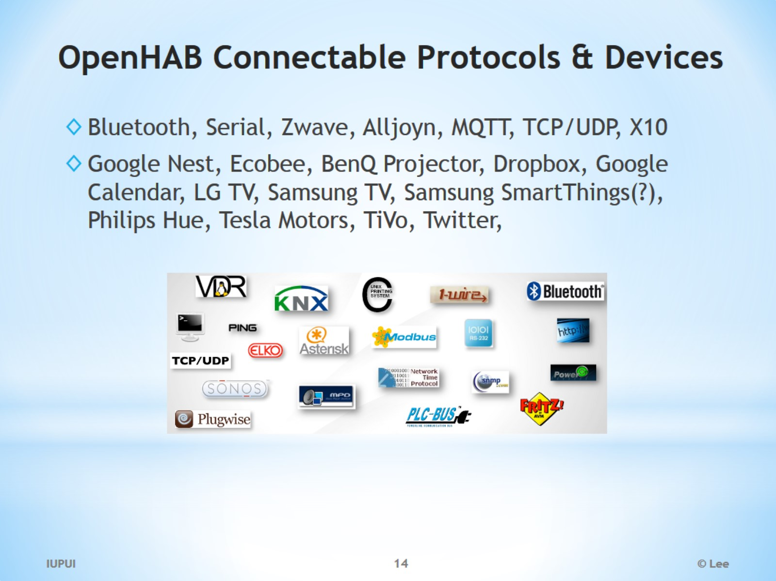
OpenHAB Connectable Protocols & Devices

Slide 15
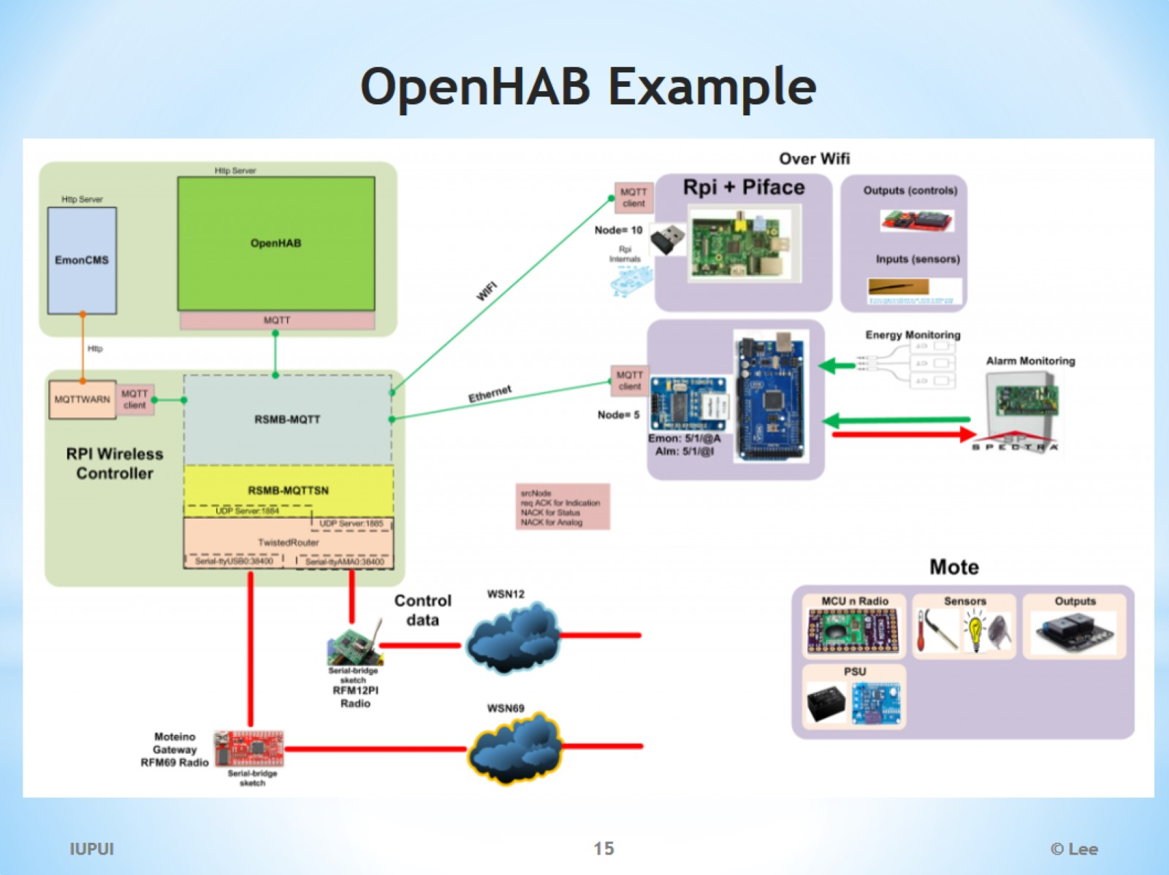
OpenHAB Example

Slide 16
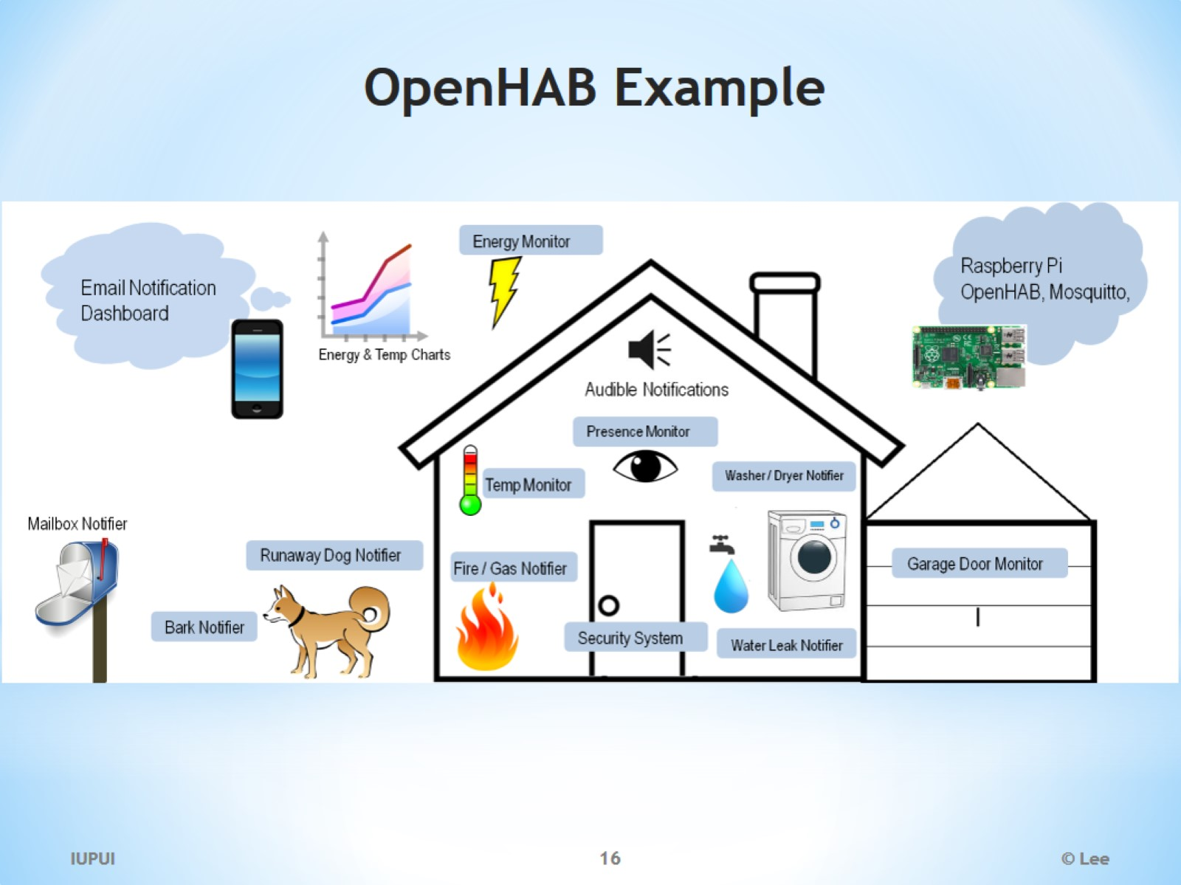
OpenHAB Example

Slide 17
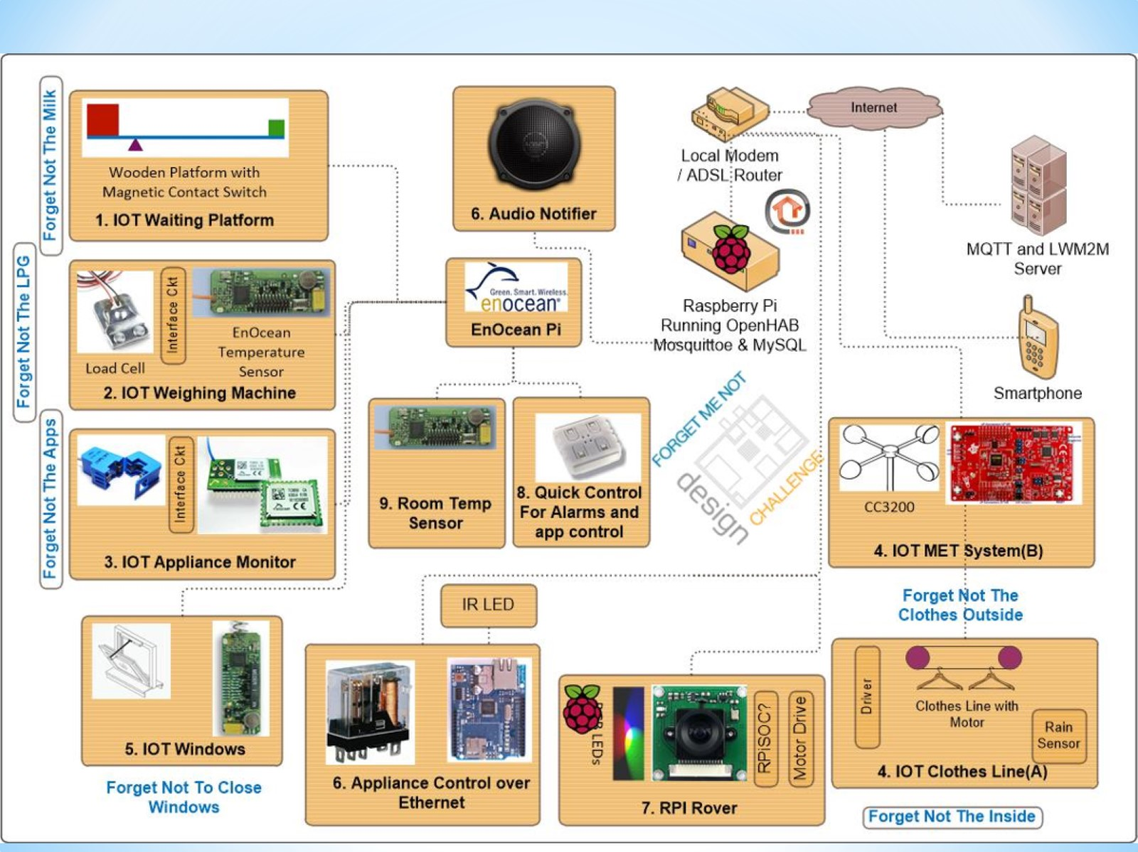

Slide 18
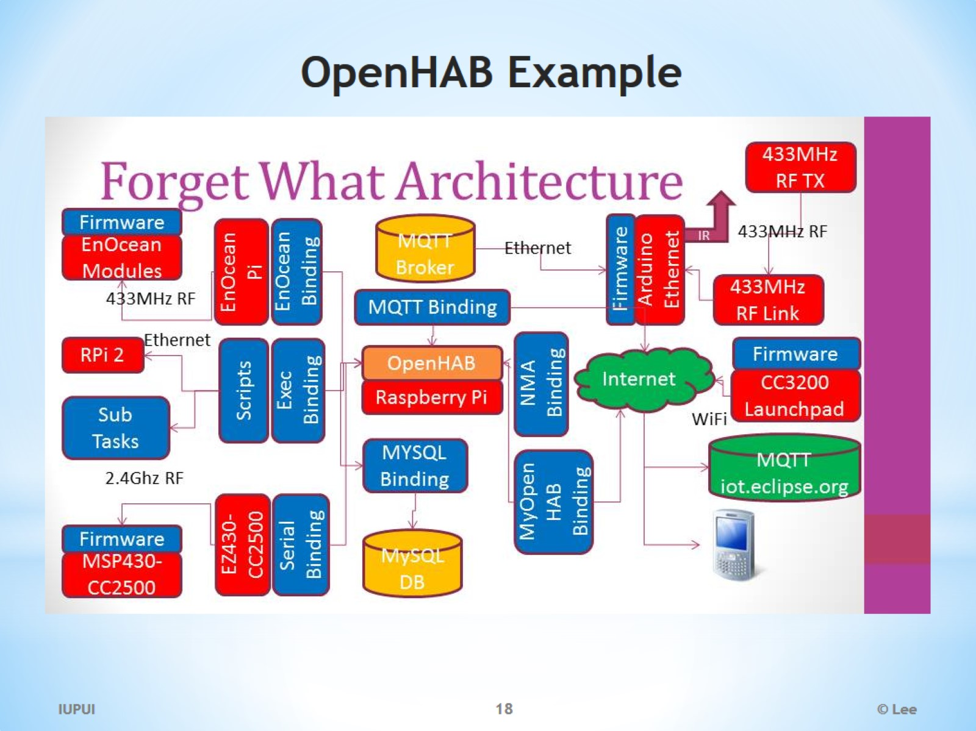
OpenHAB Example

Slide 19
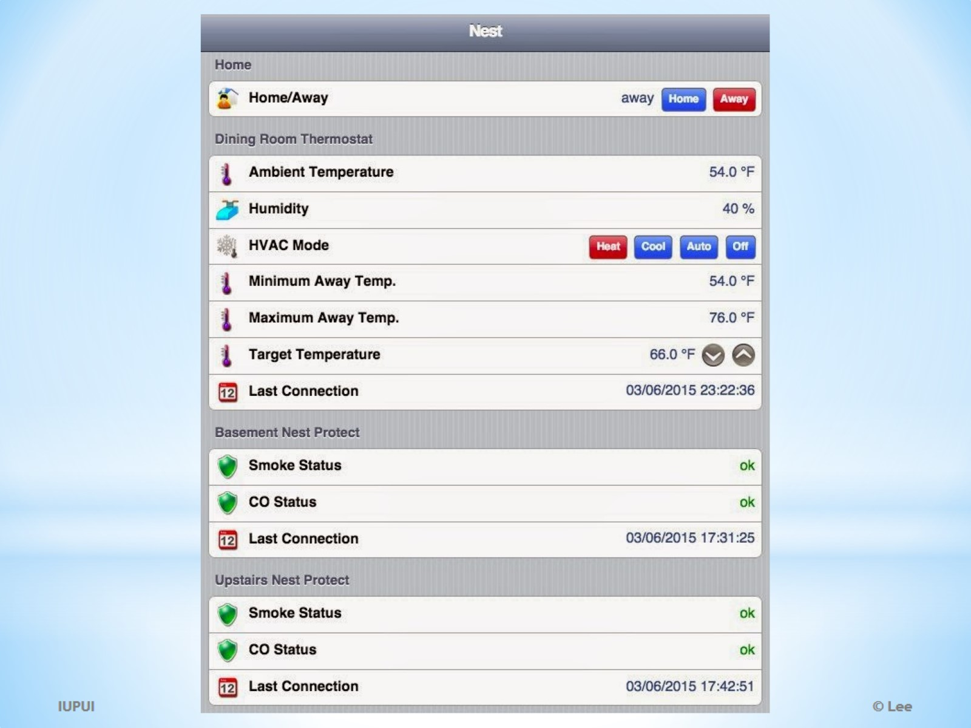

Slide 20
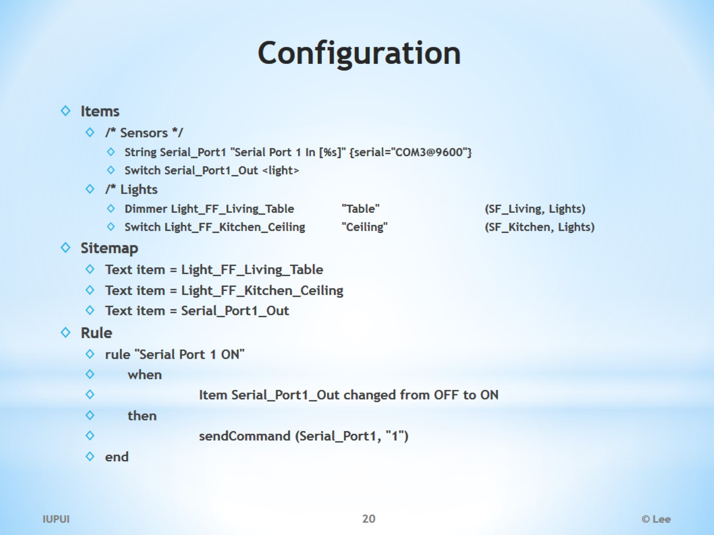
Configuration

Slide 21
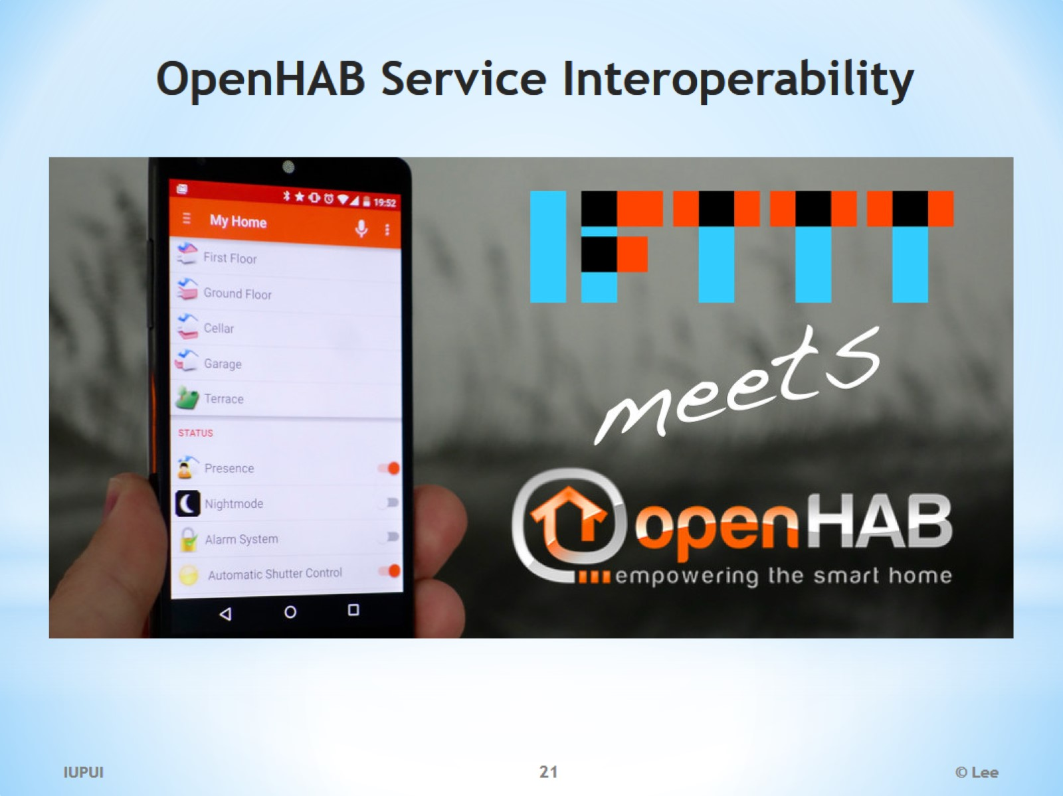
OpenHAB Service Interoperability

Slide 22
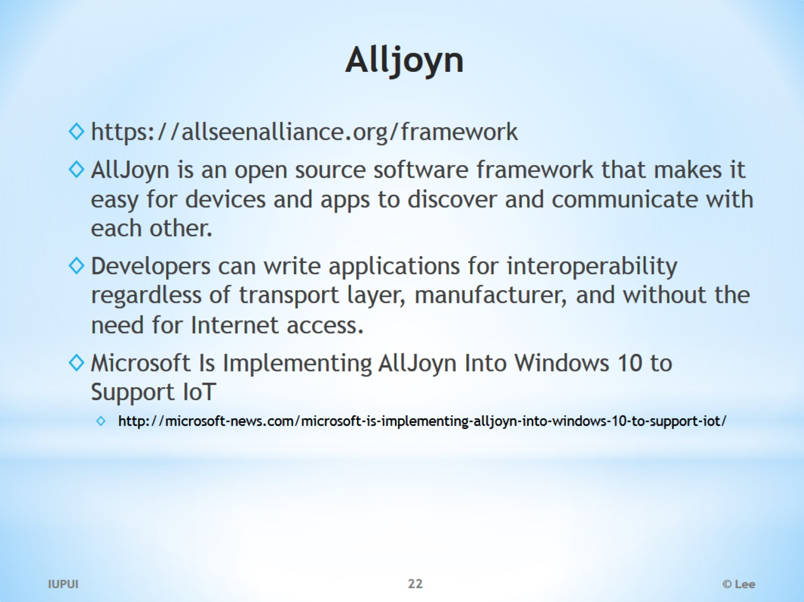
Alljoyn

Slide 23
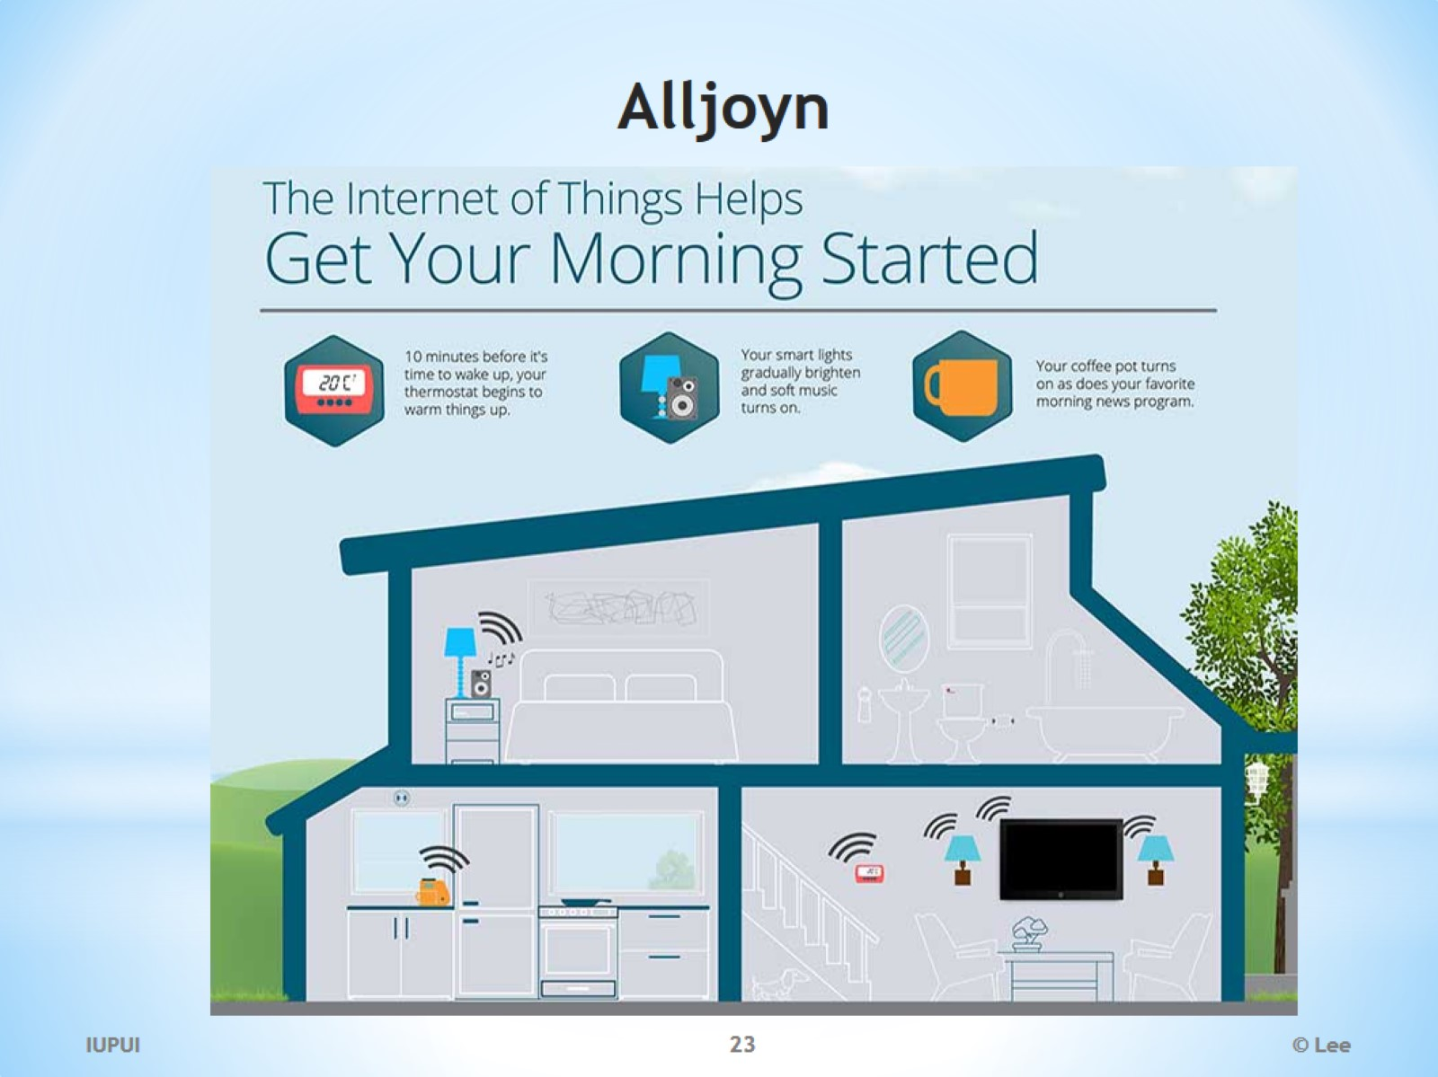
Alljoyn

Slide 24


Slide 25


Slide 26
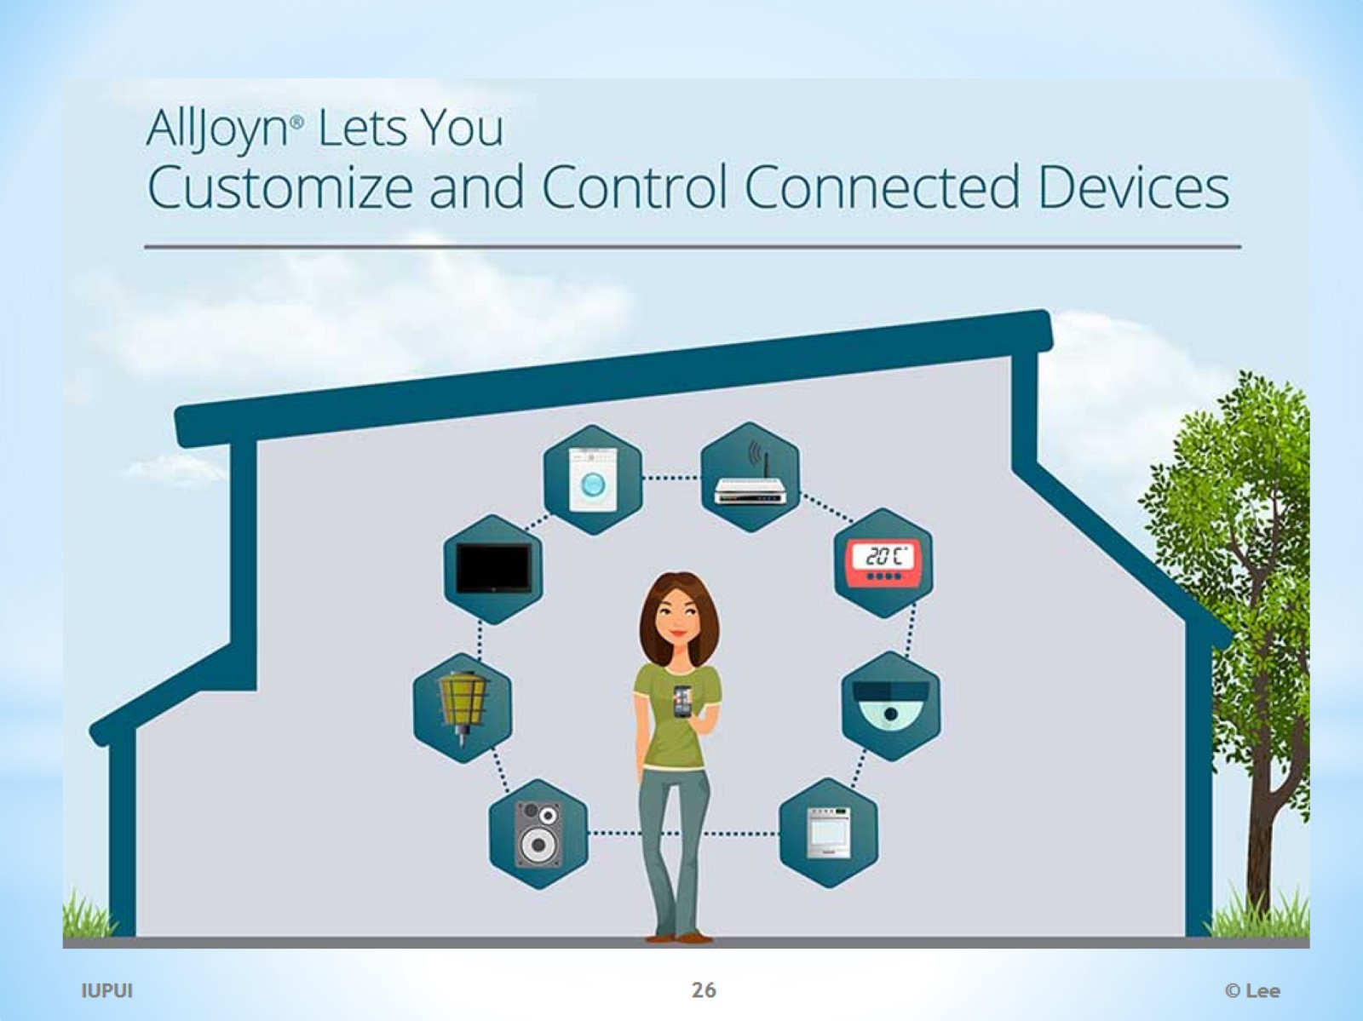

Slide 27
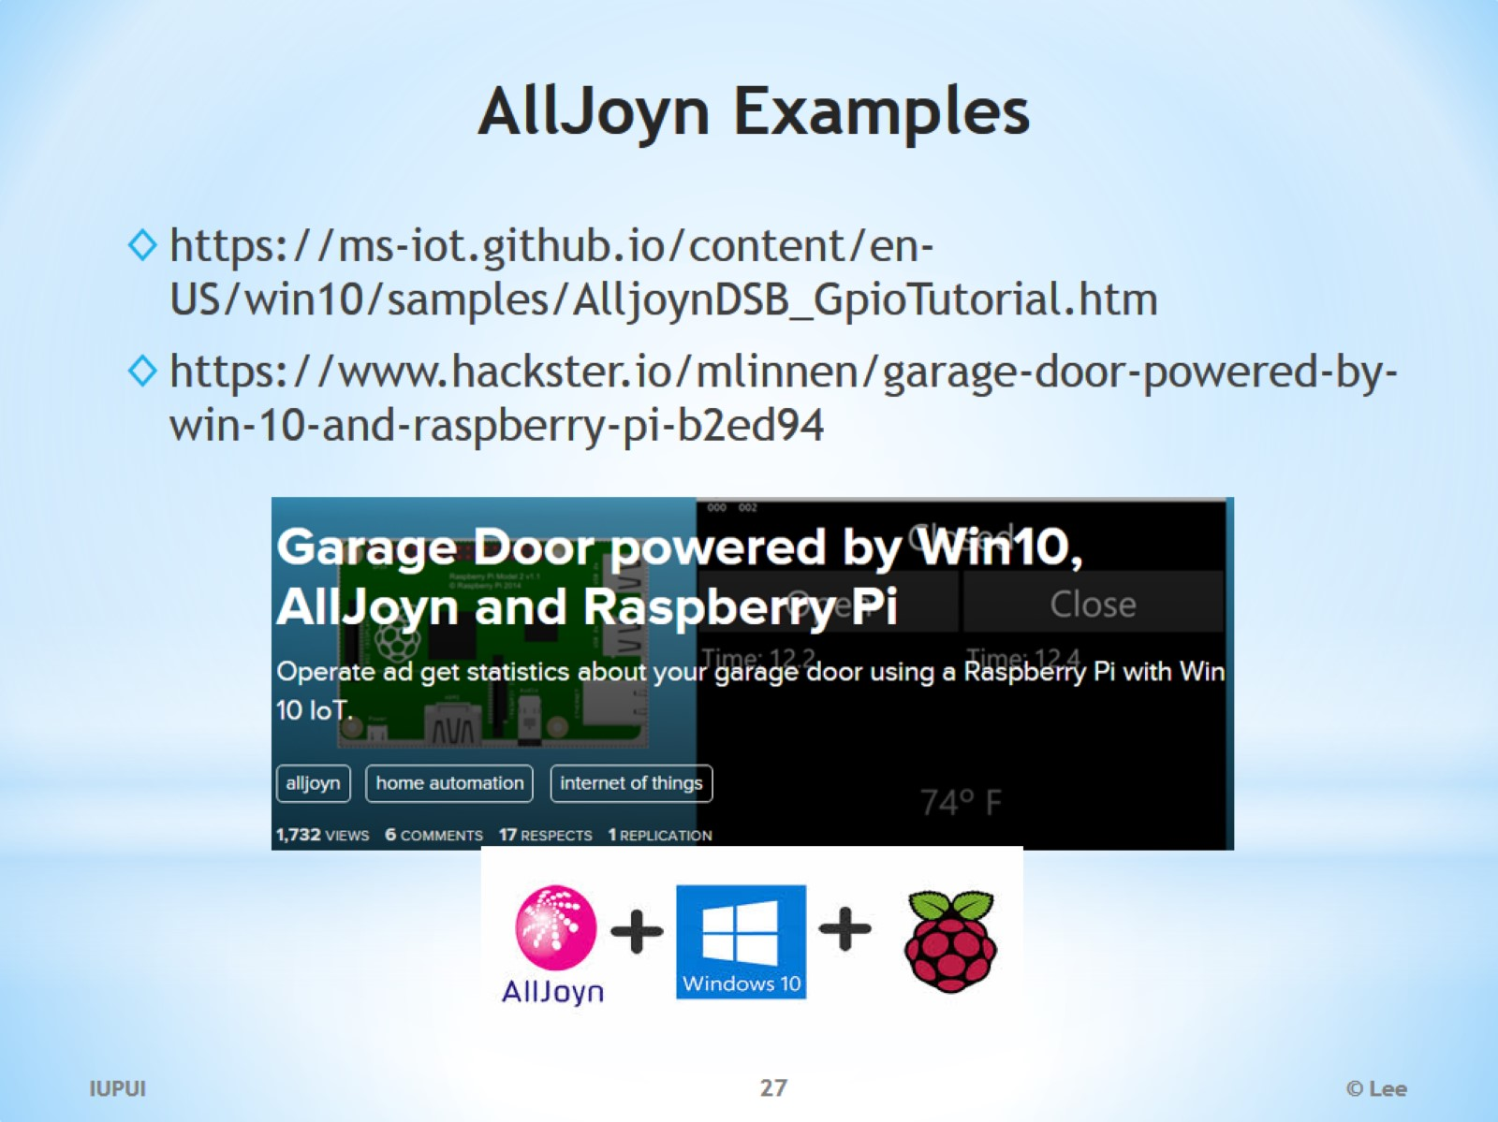
AllJoyn Examples

Slide 28
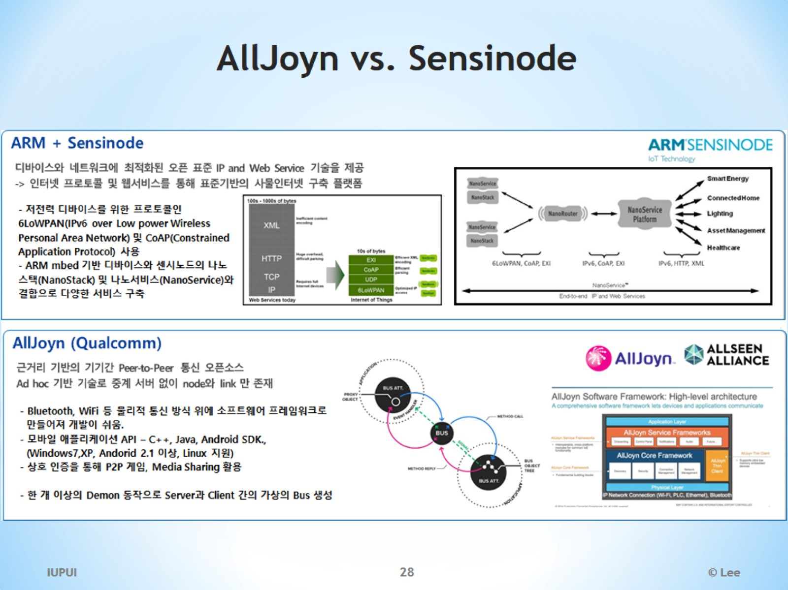
AllJoyn vs. Sensinode

Slide 29
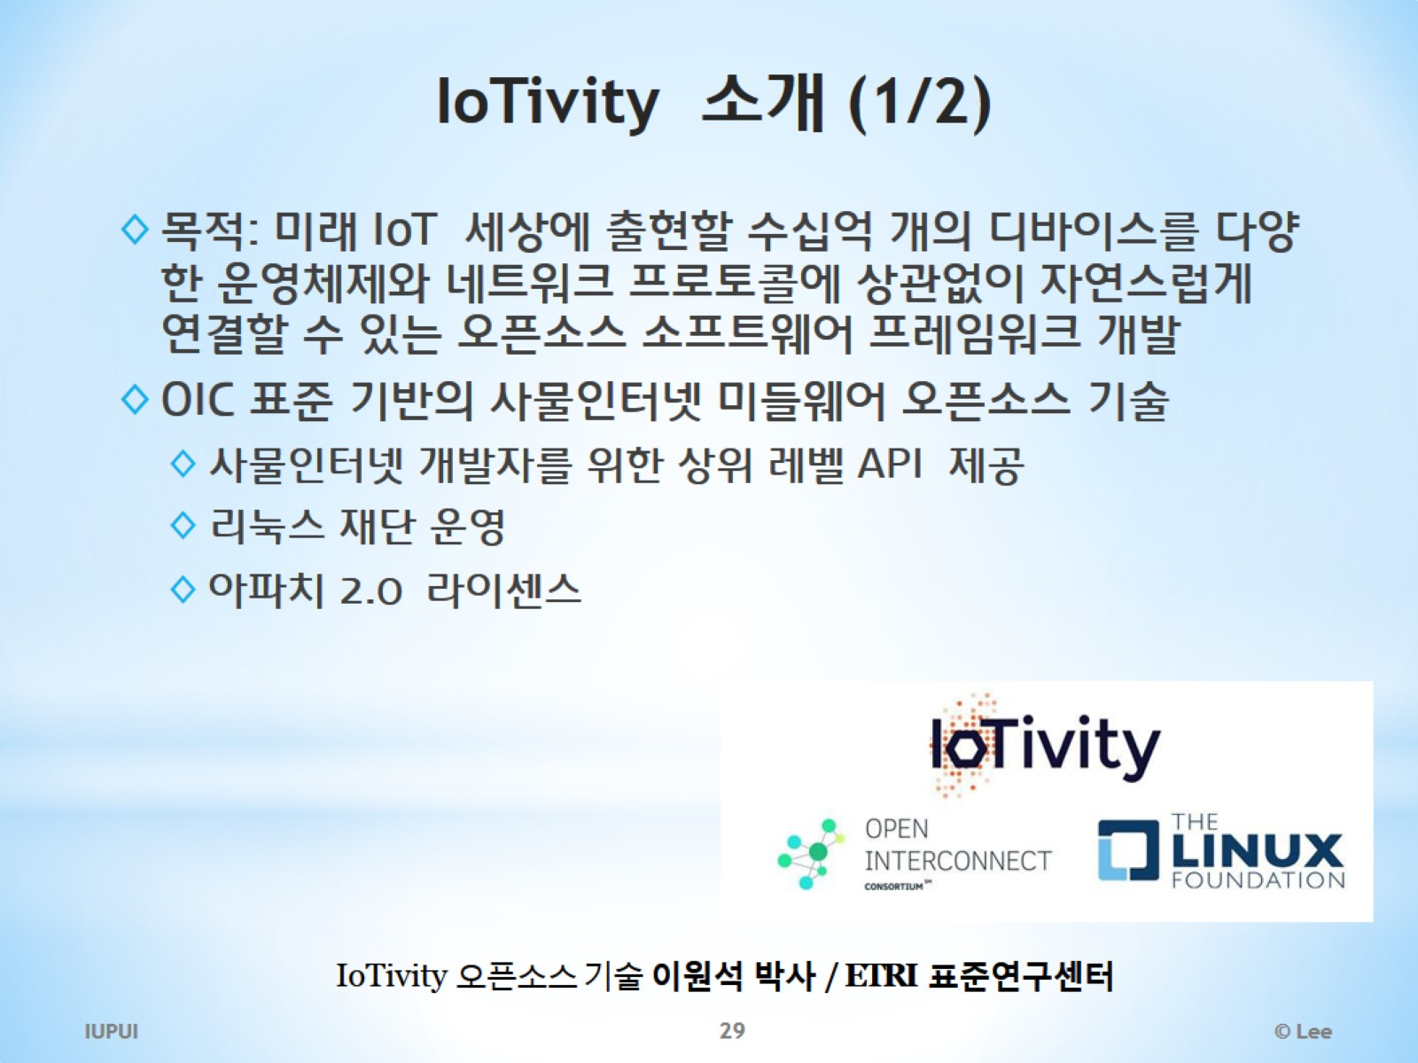
IoTivity 소개 (1/2)

Slide 30
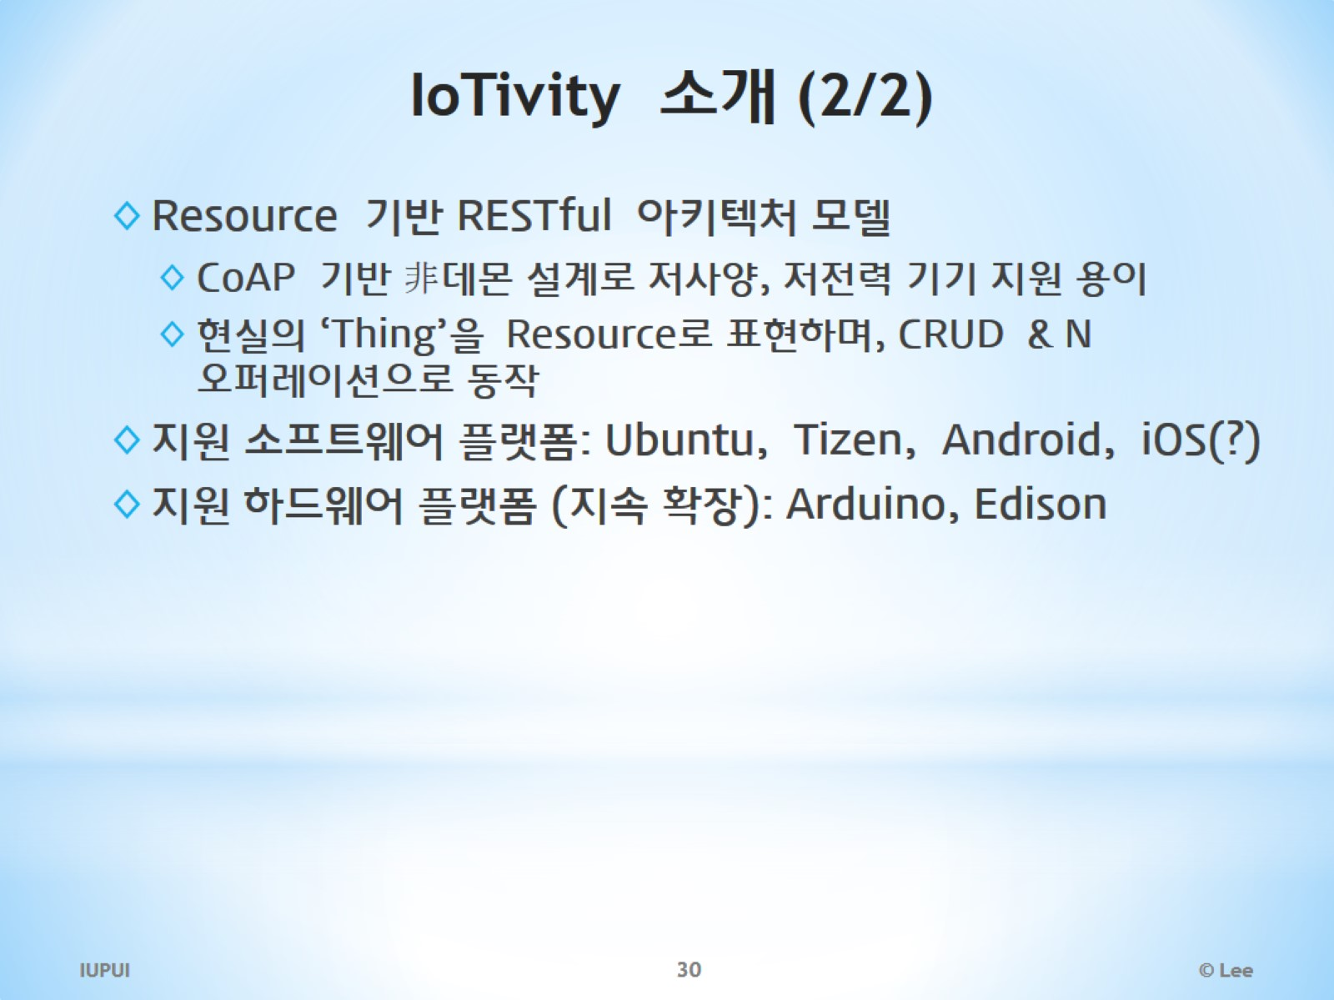
IoTivity 소개 (2/2)

Slide 31
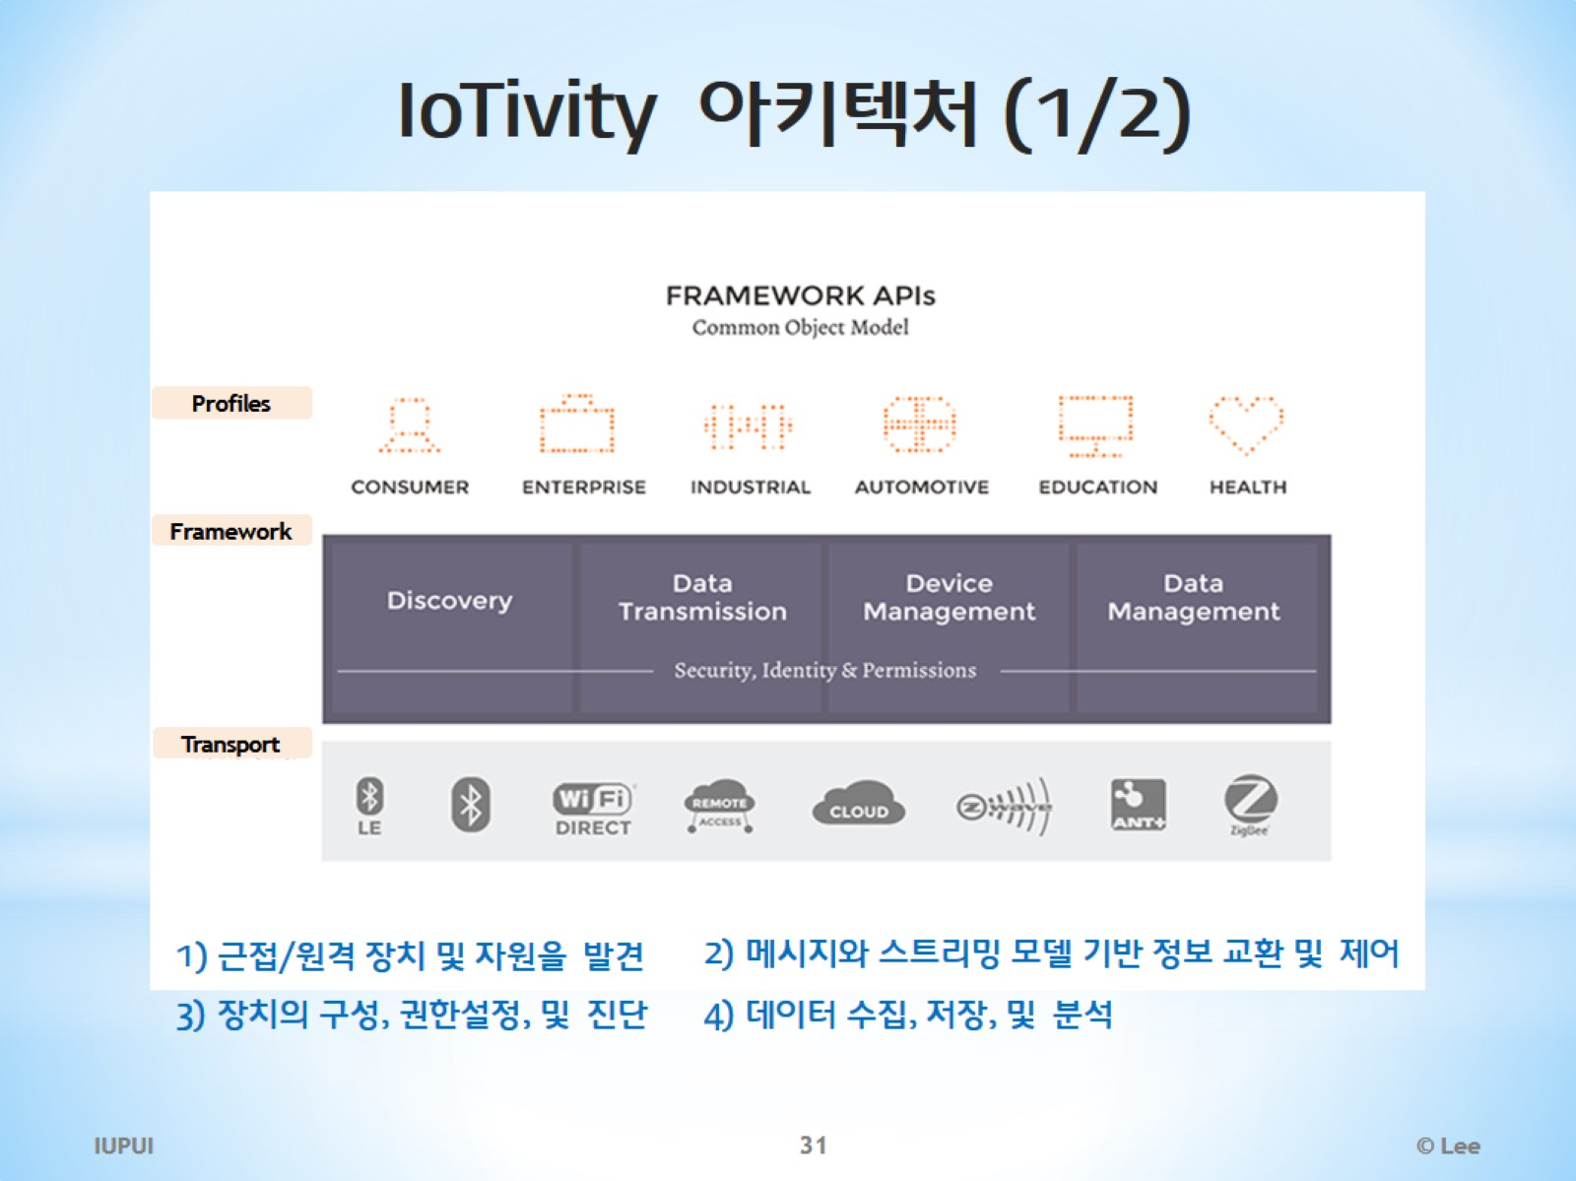
IoTivity 아키텍처 (1/2)

Slide 32
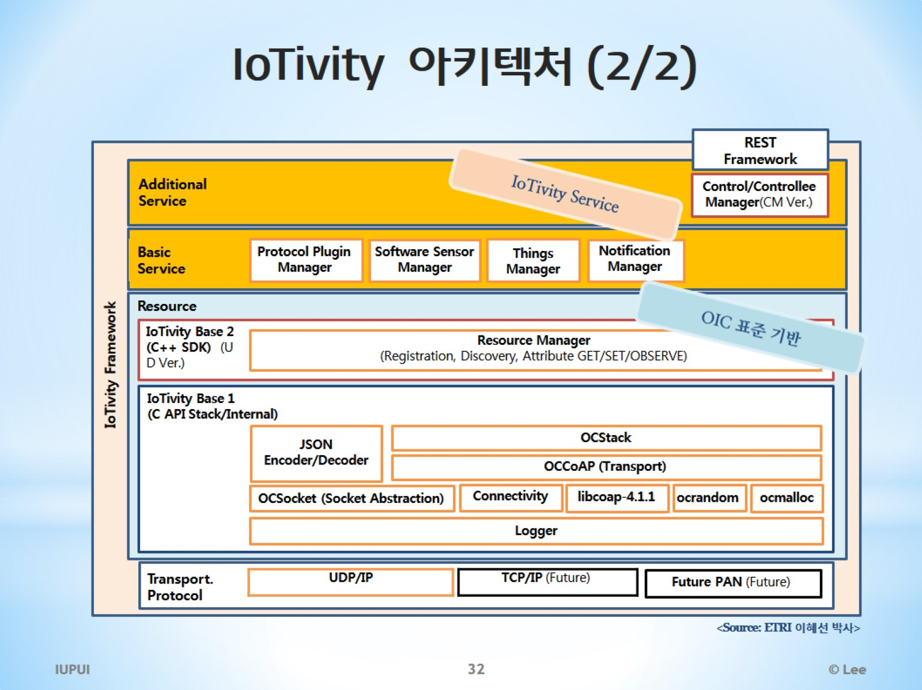
IoTivity 아키텍처 (2/2)

Slide 33
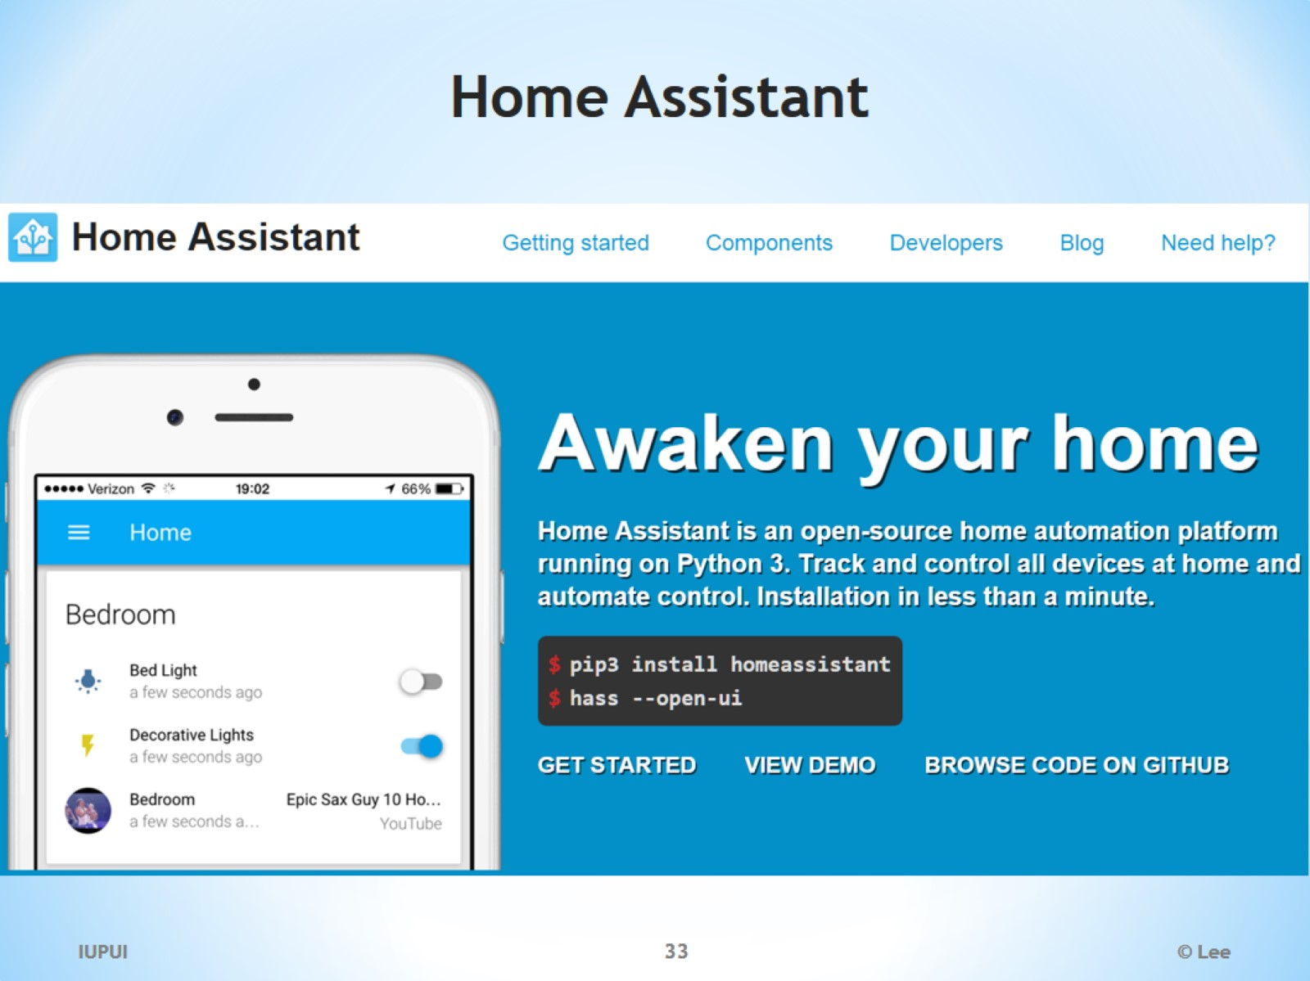
Home Assistant

Slide 34
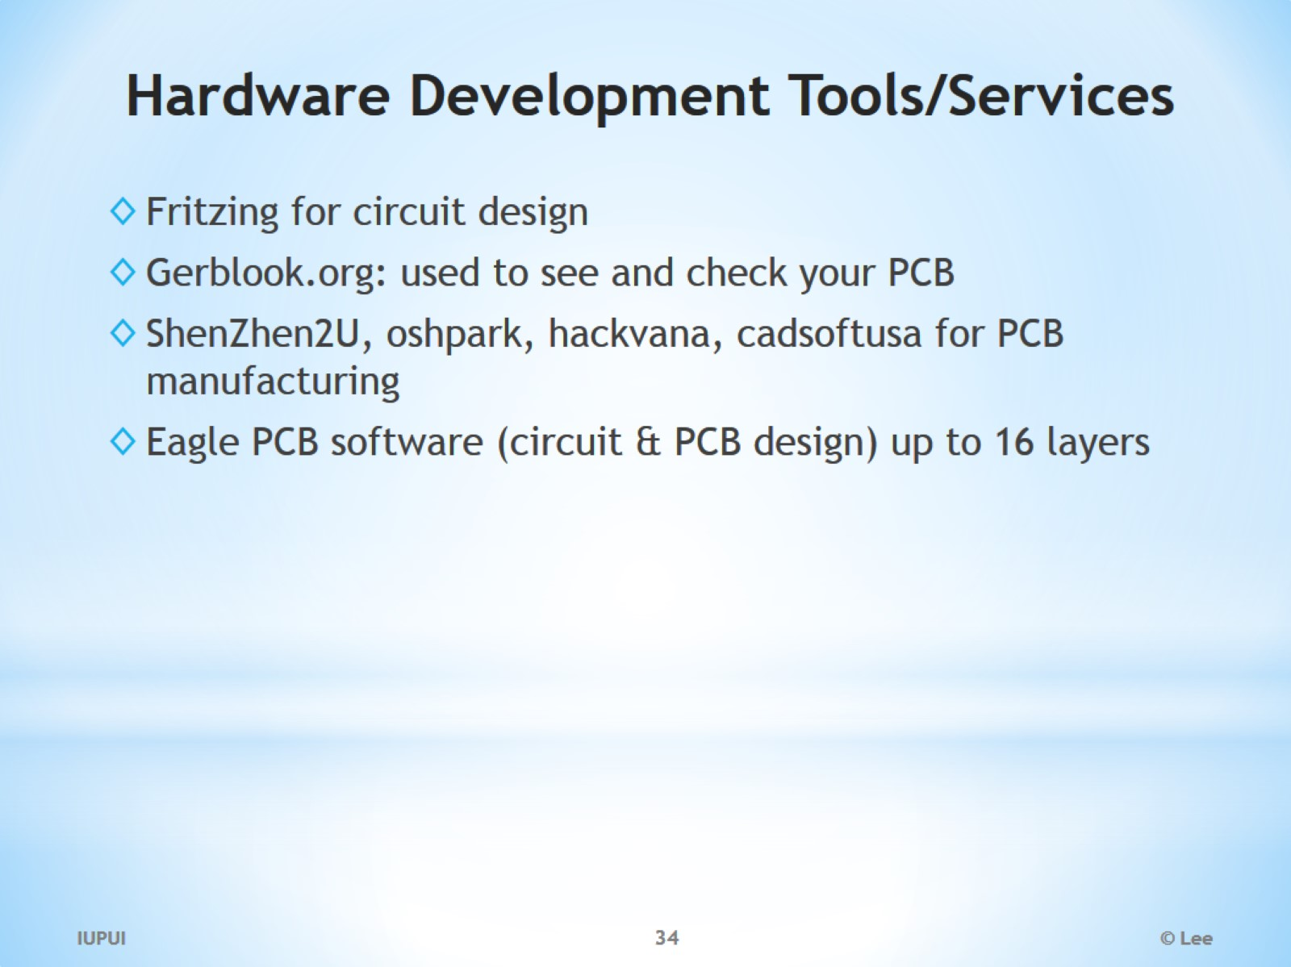
Hardware Development Tools/Services

Slide 35
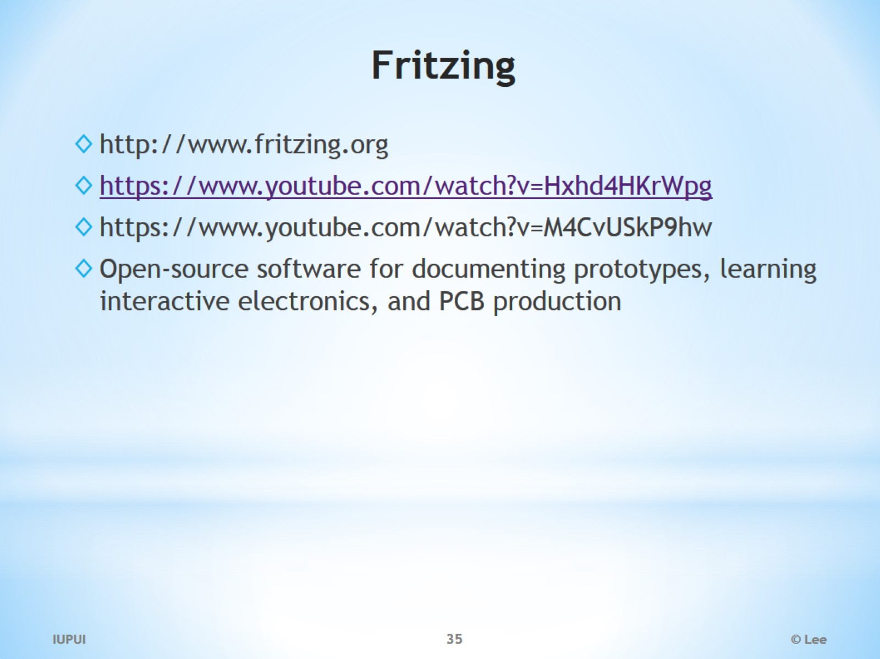
Fritzing

Slide 36
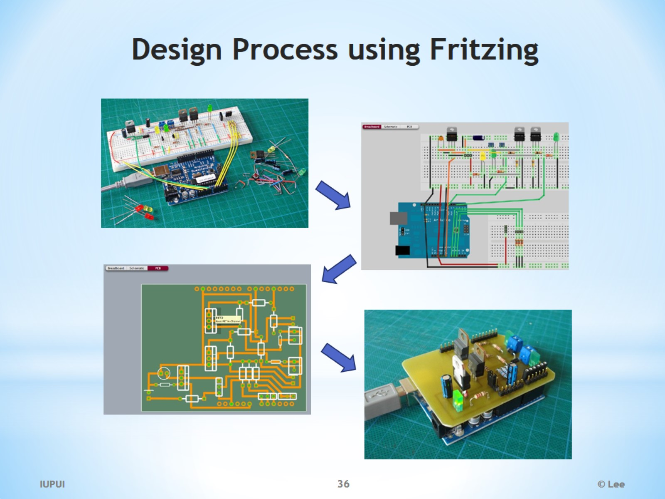
Design Process using Fritzing

Slide 37
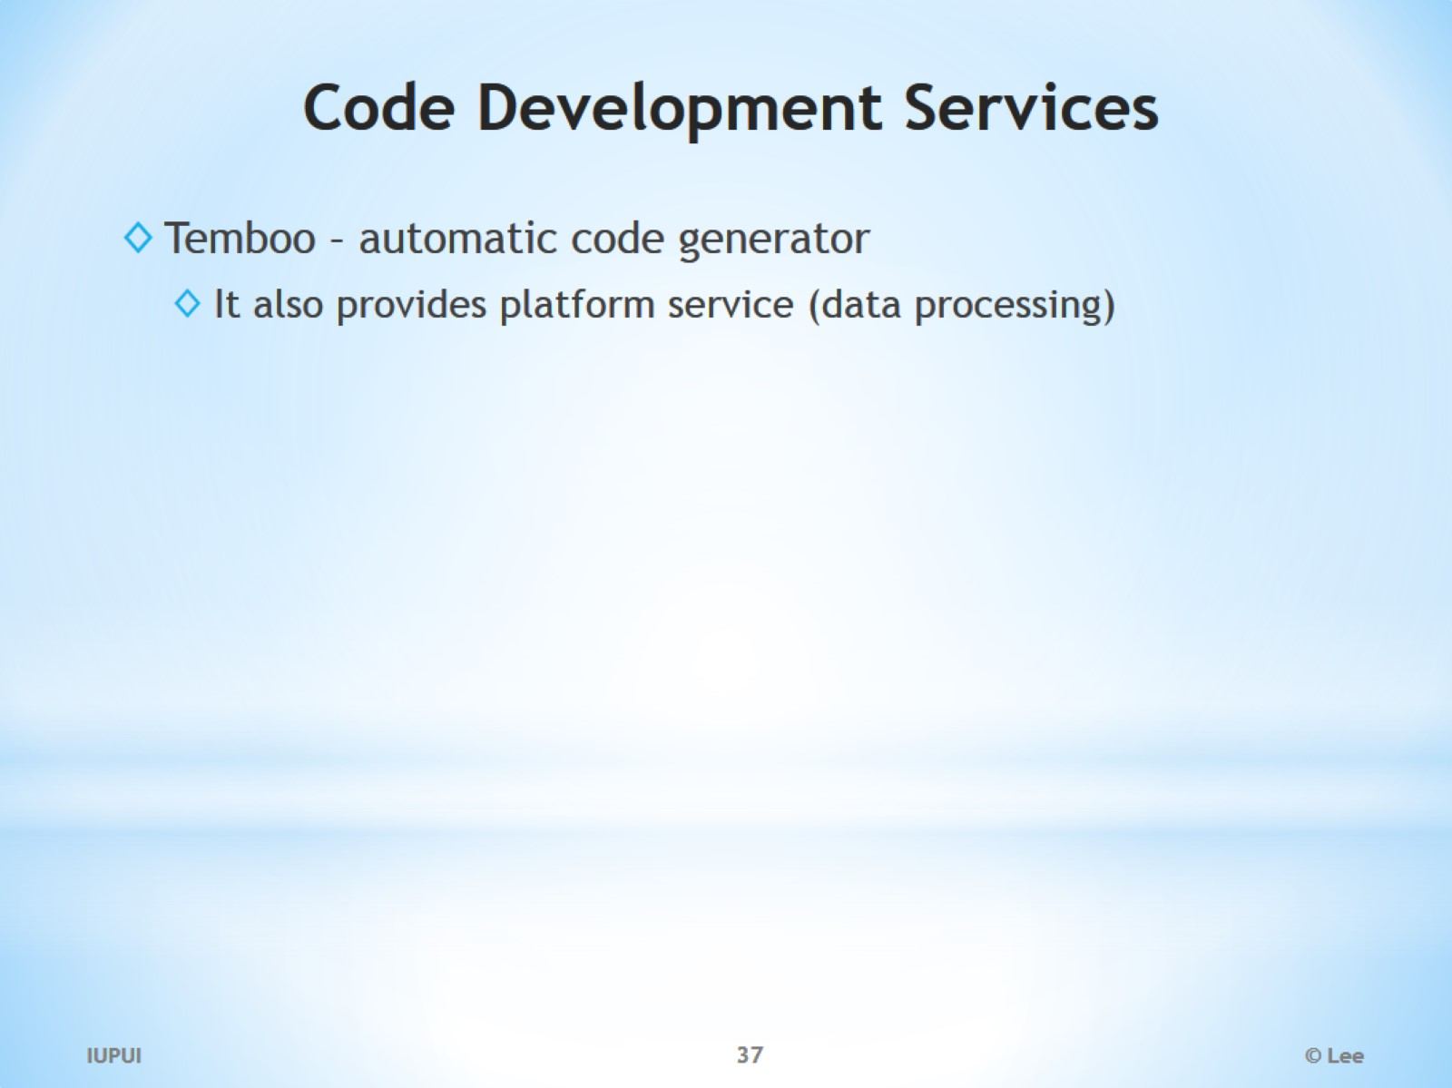
Code Development Services

Slide 38
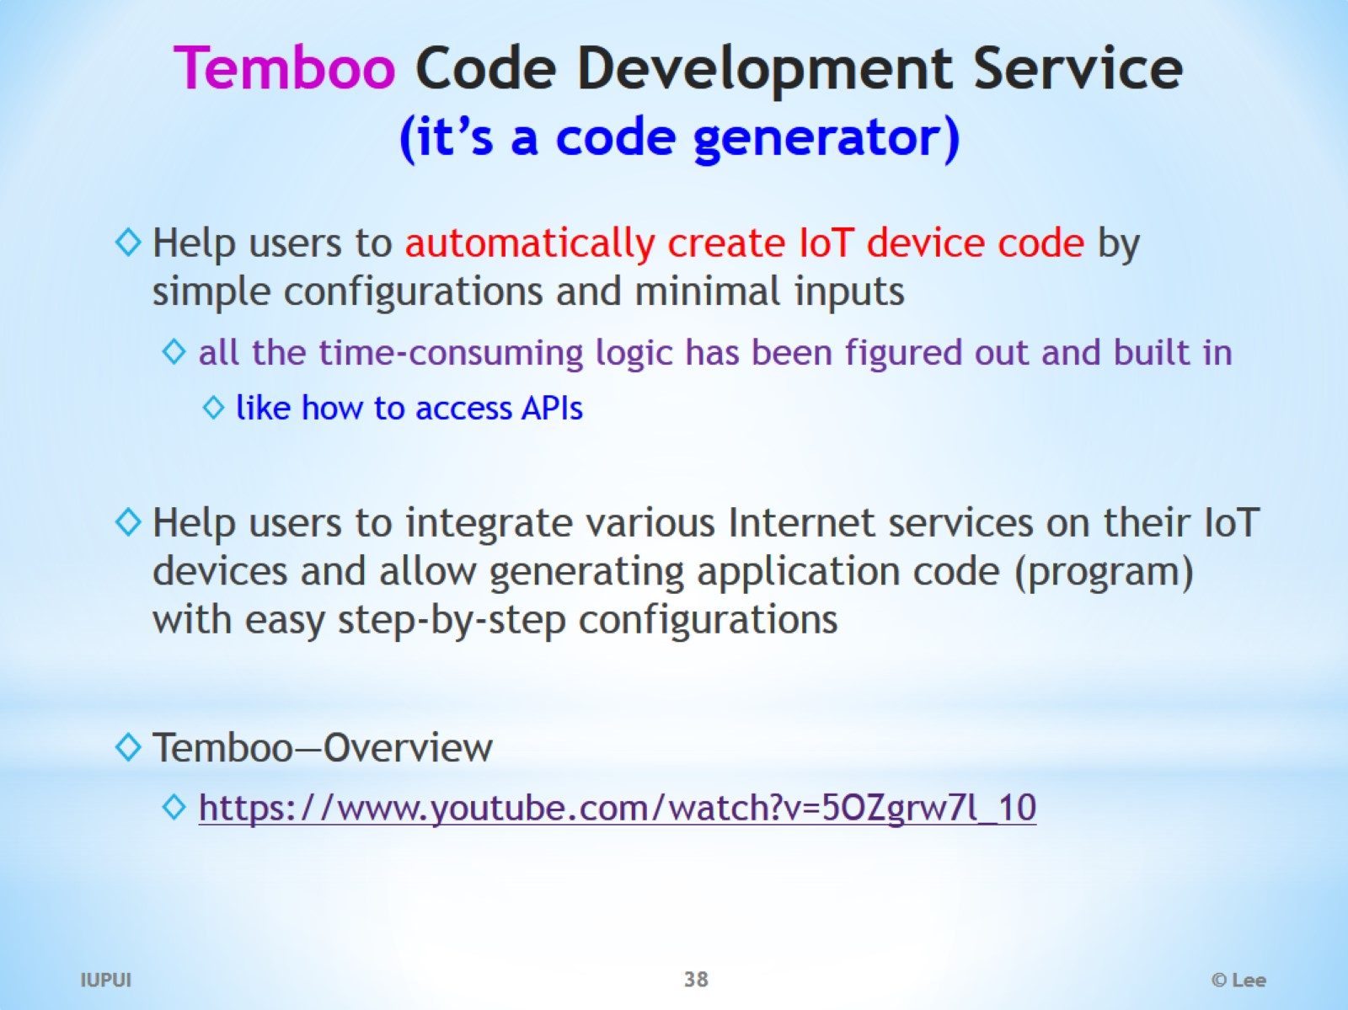
Temboo Code Development Service (it’s a code generator)

Slide 39
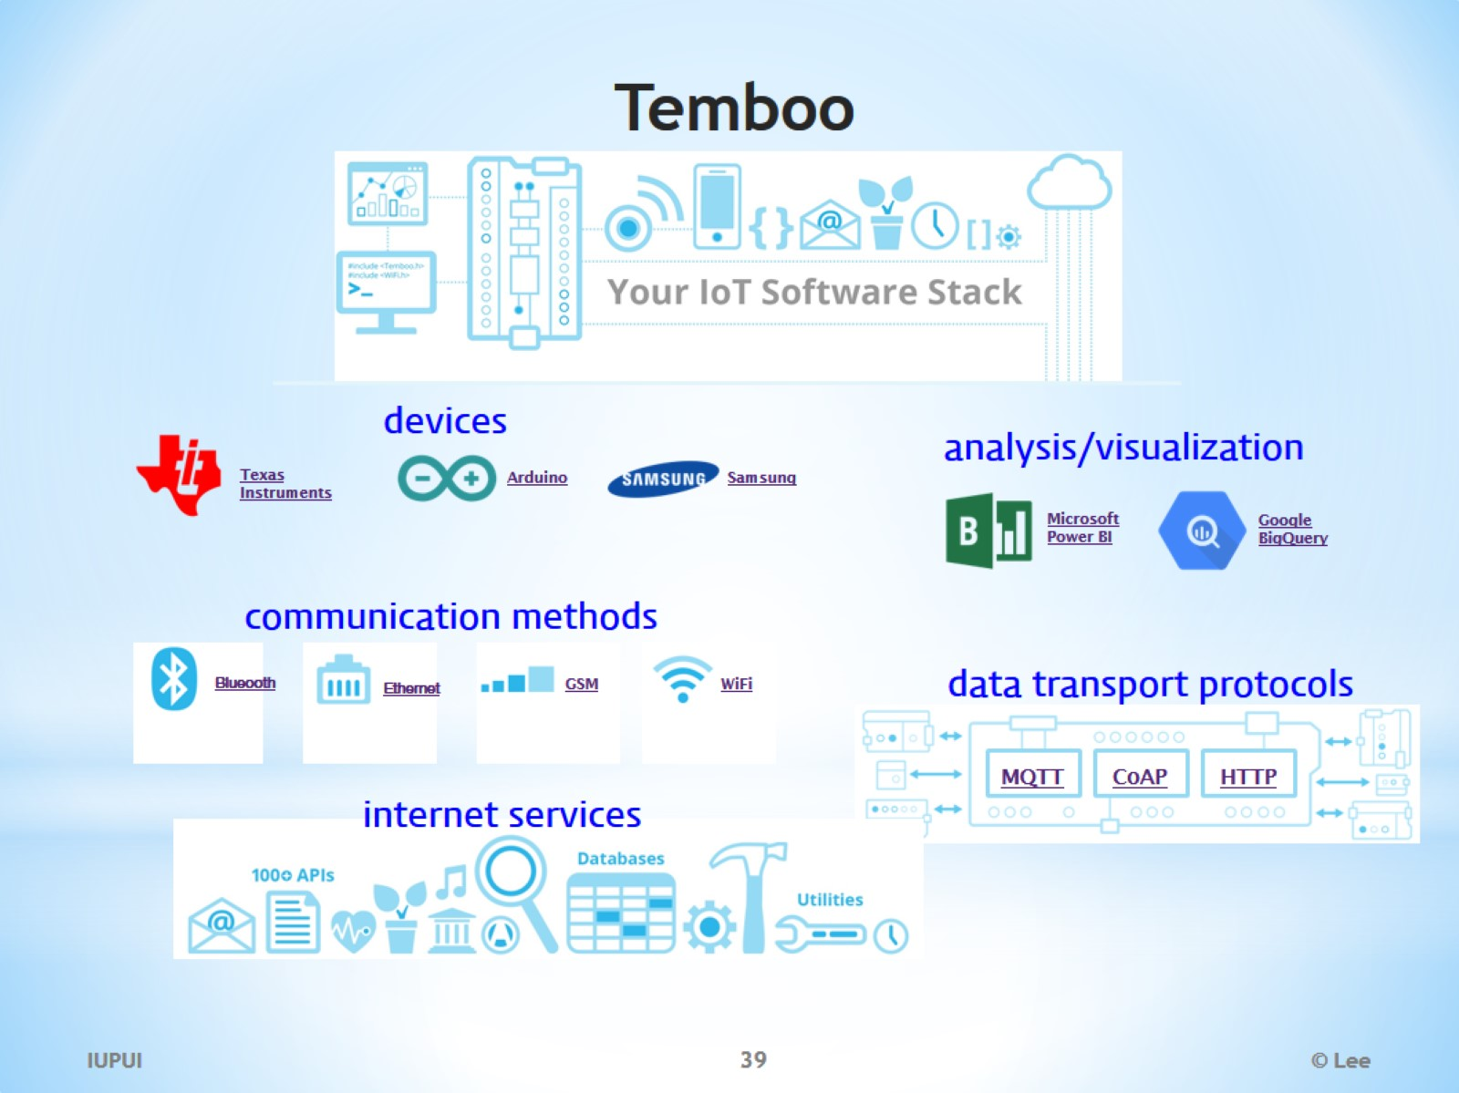
Temboo

Slide 40
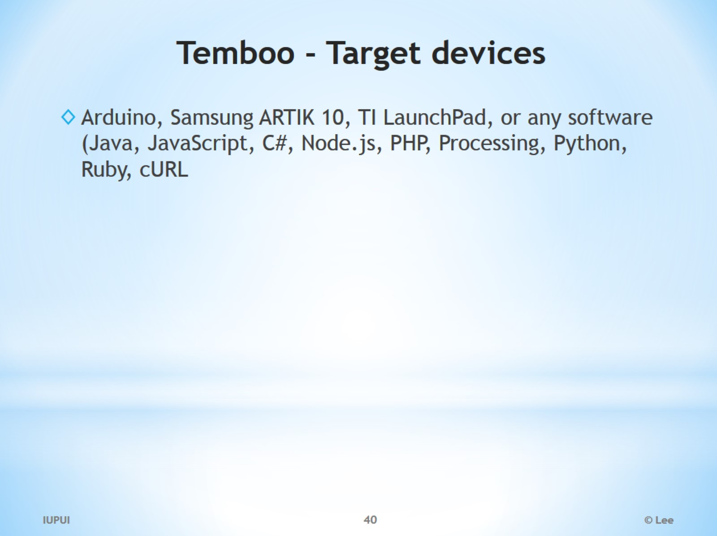
Temboo - Target devices

Slide 41
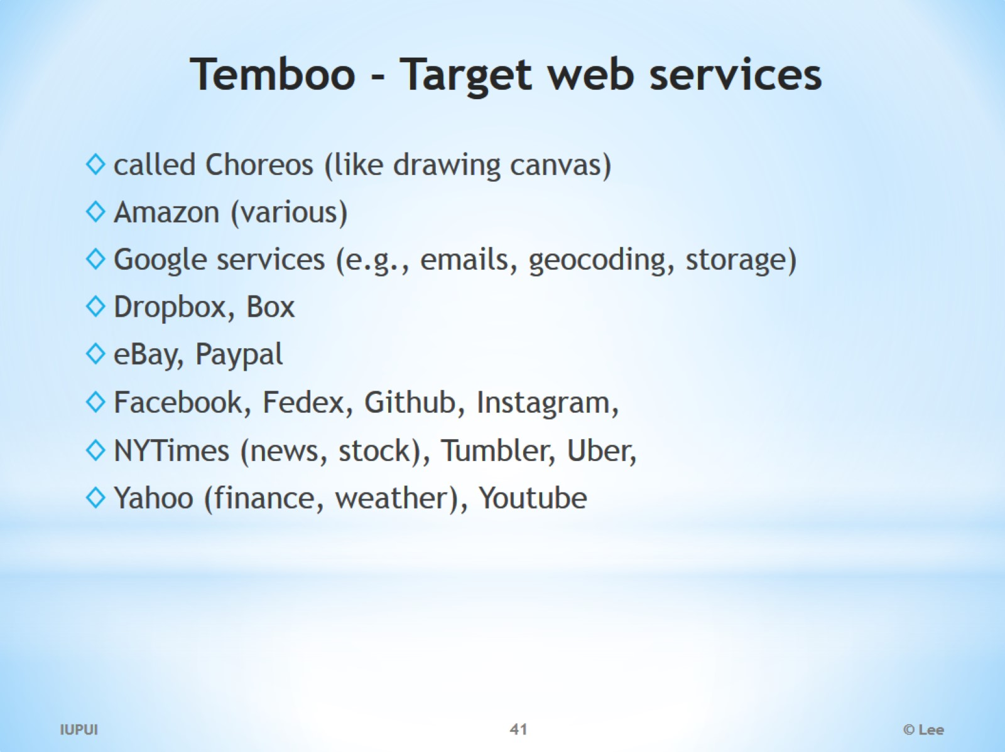
Temboo - Target web services

Slide 42
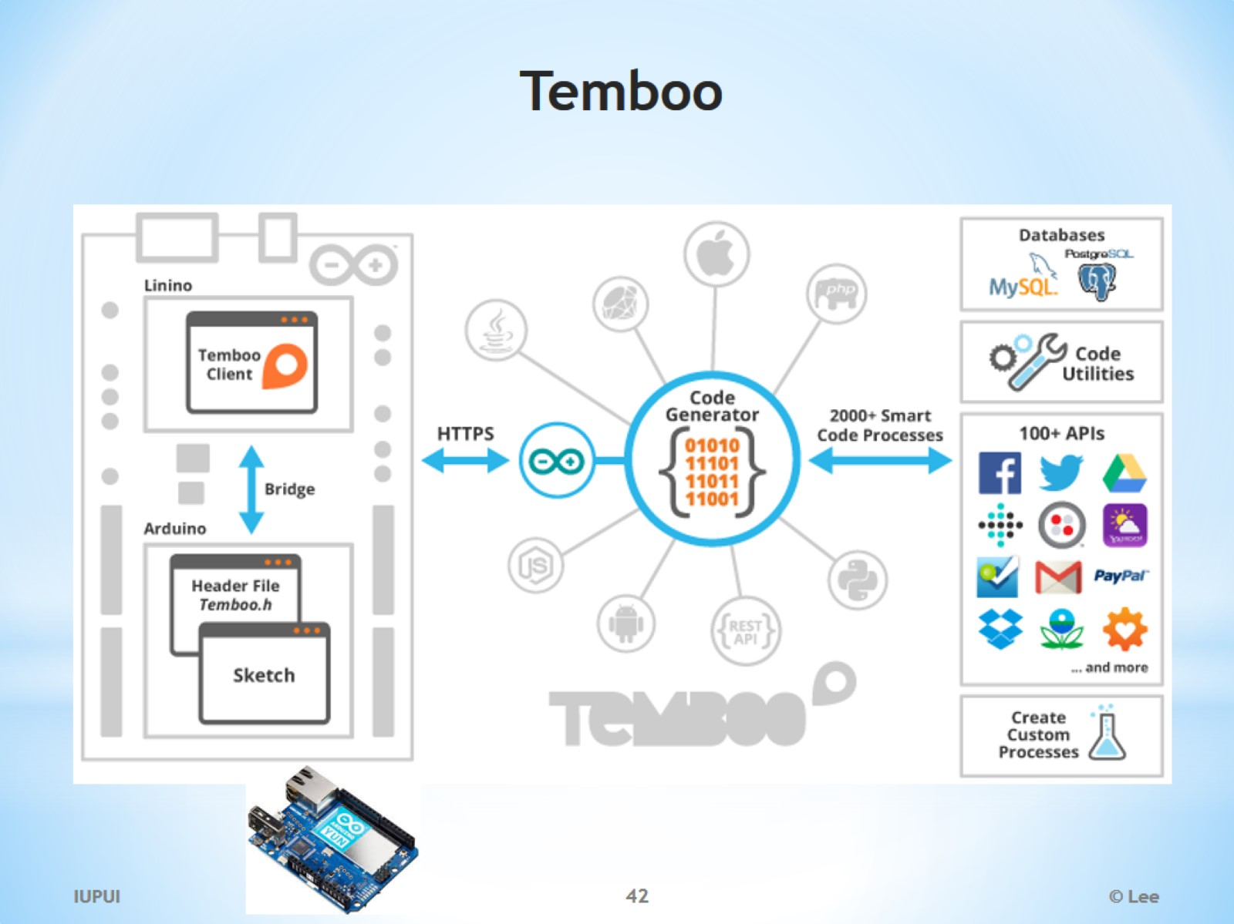
Temboo

Slide 43
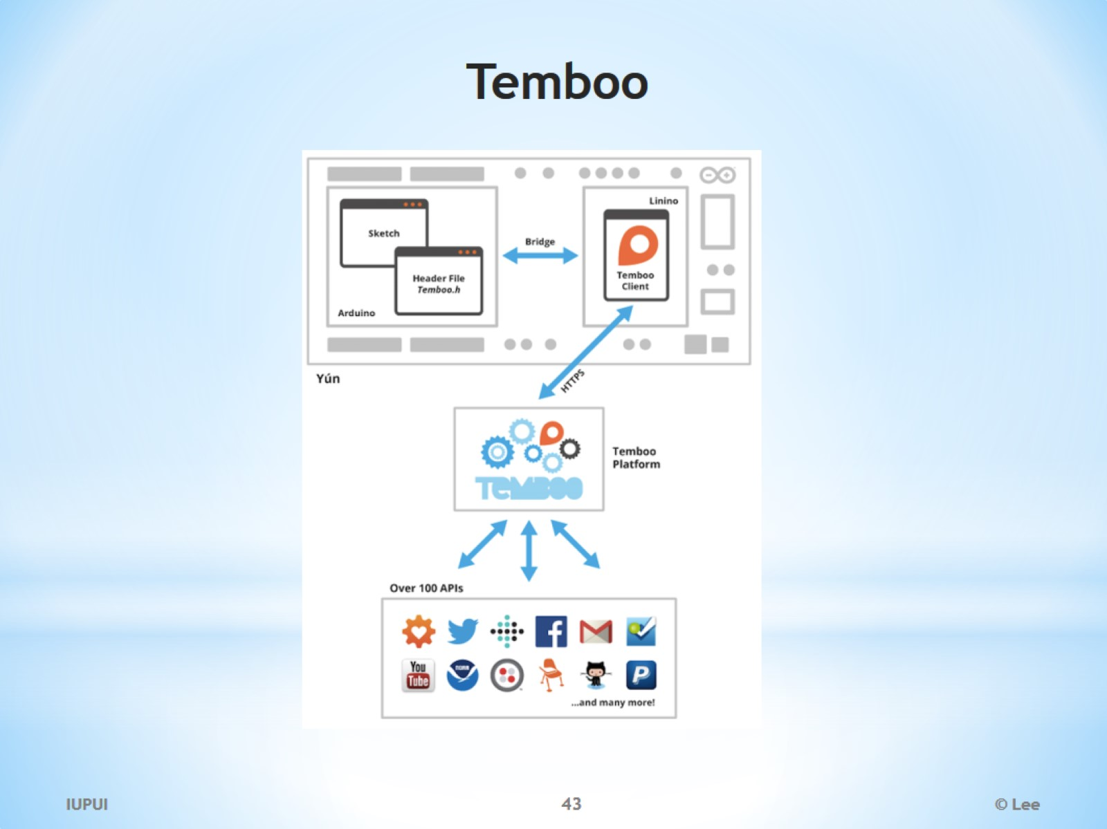
Temboo

Slide 44
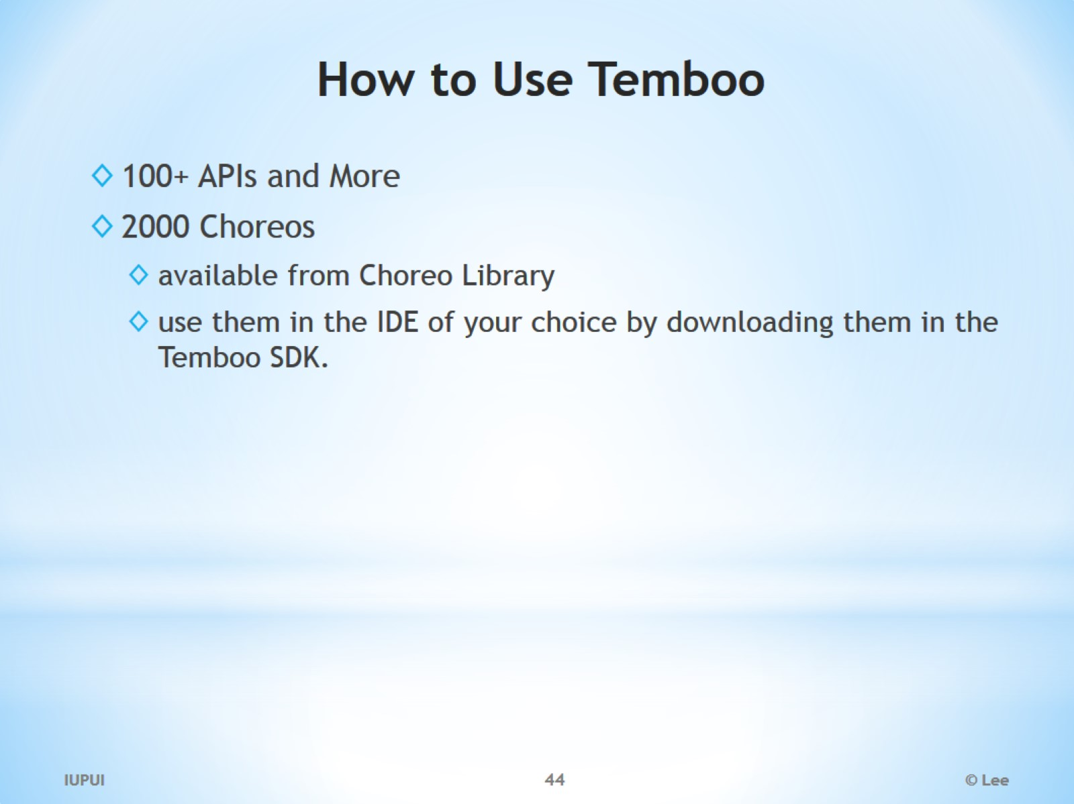
How to Use Temboo

Slide 45
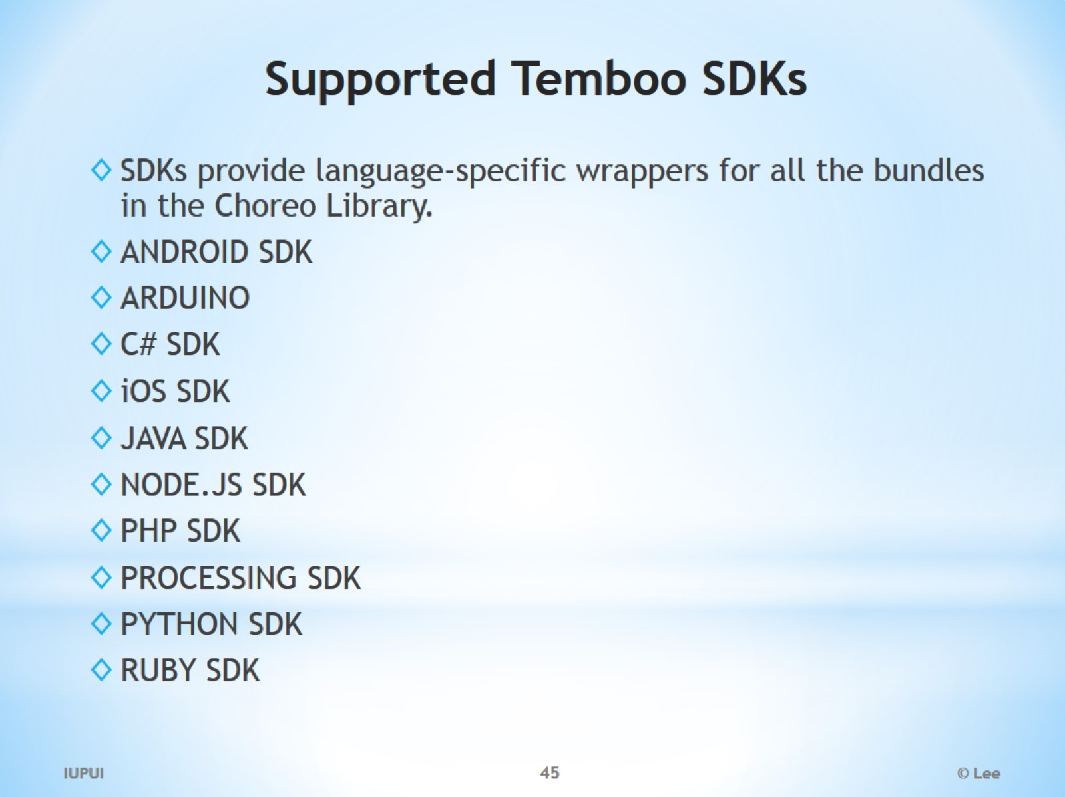
Supported Temboo SDKs

Slide 46
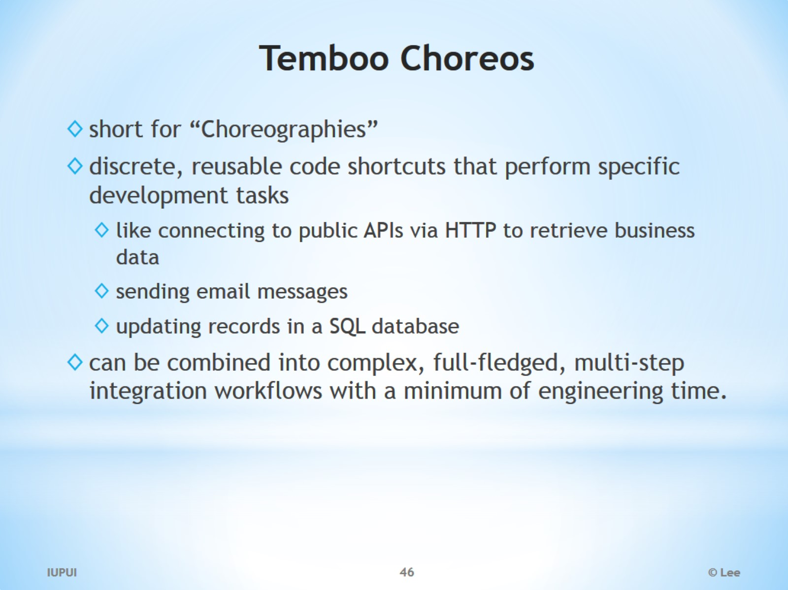
Temboo Choreos

Slide 47
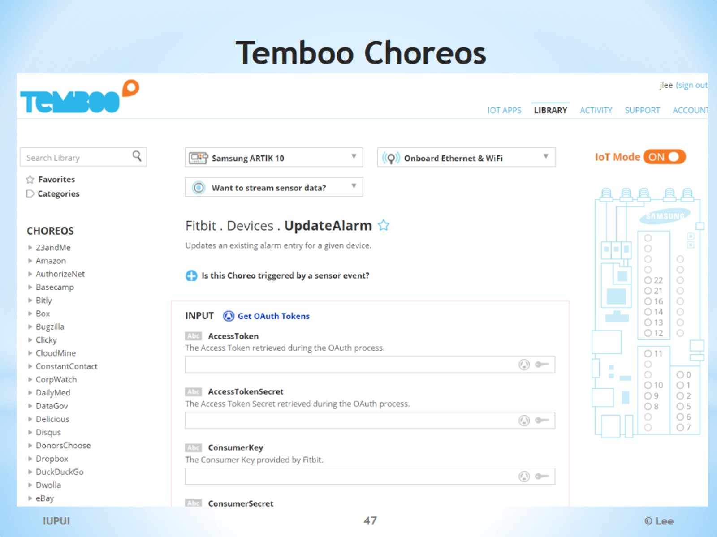
Temboo Choreos

Slide 48
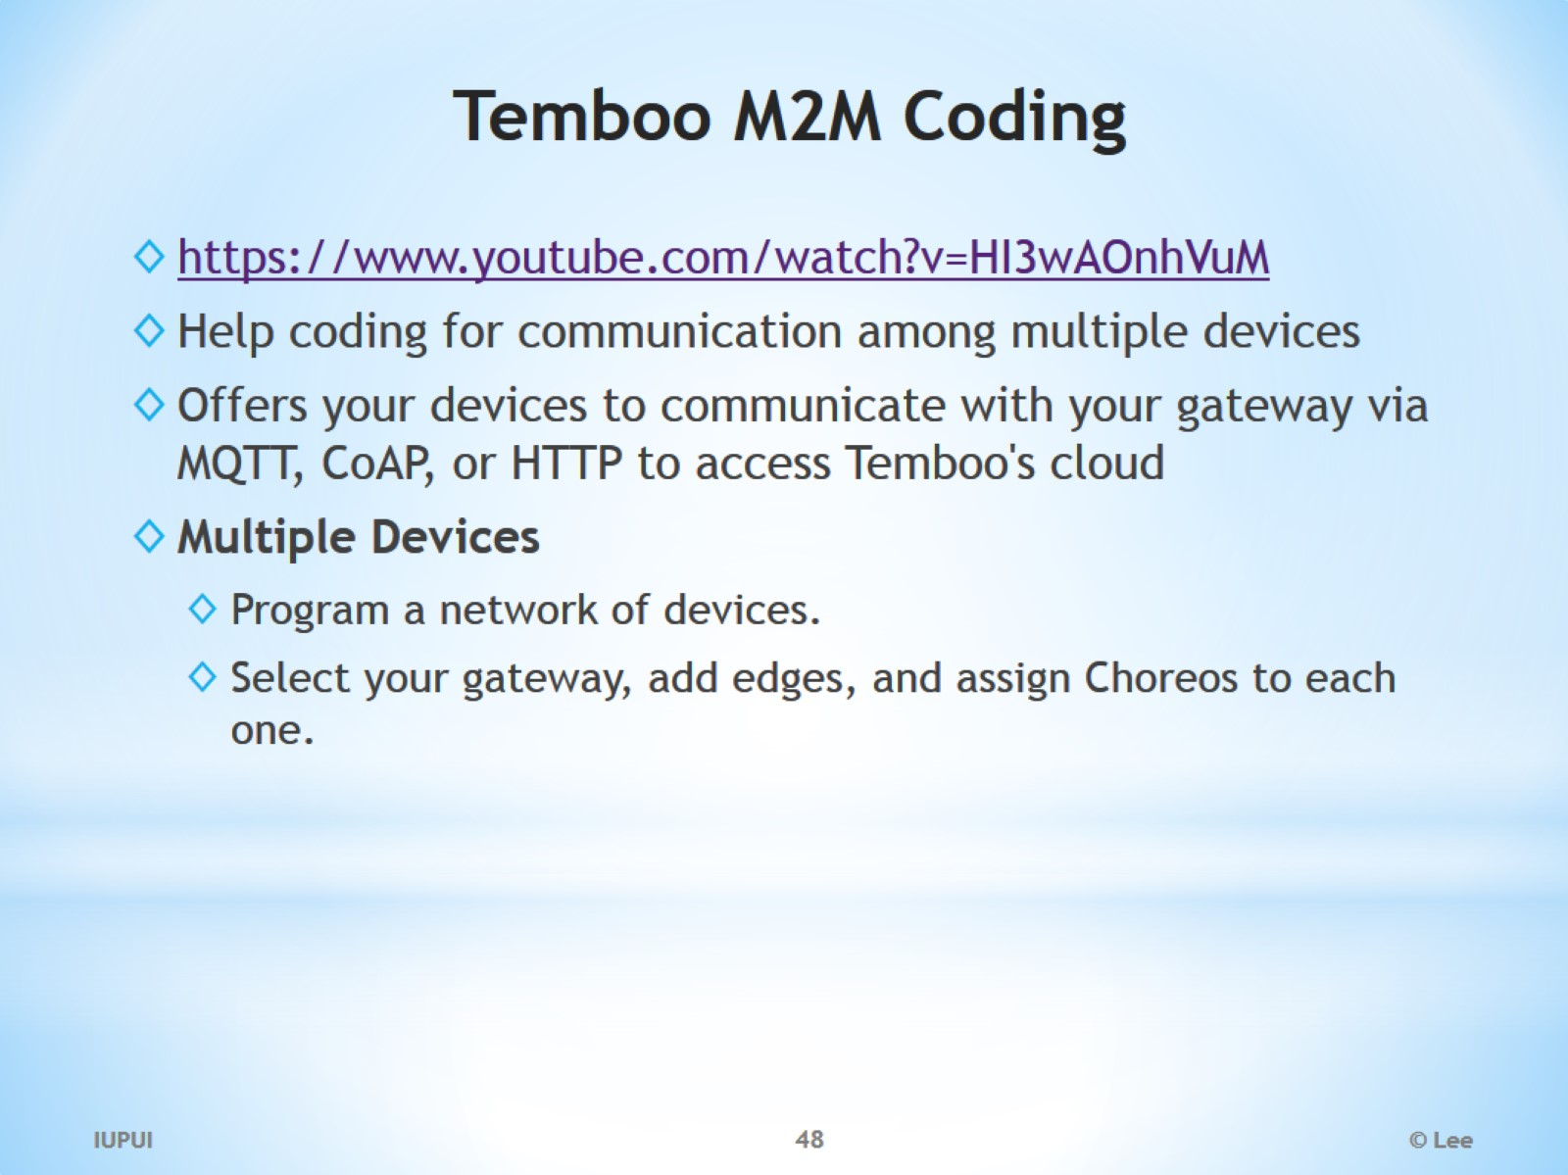
Temboo M2M Coding

Slide 49
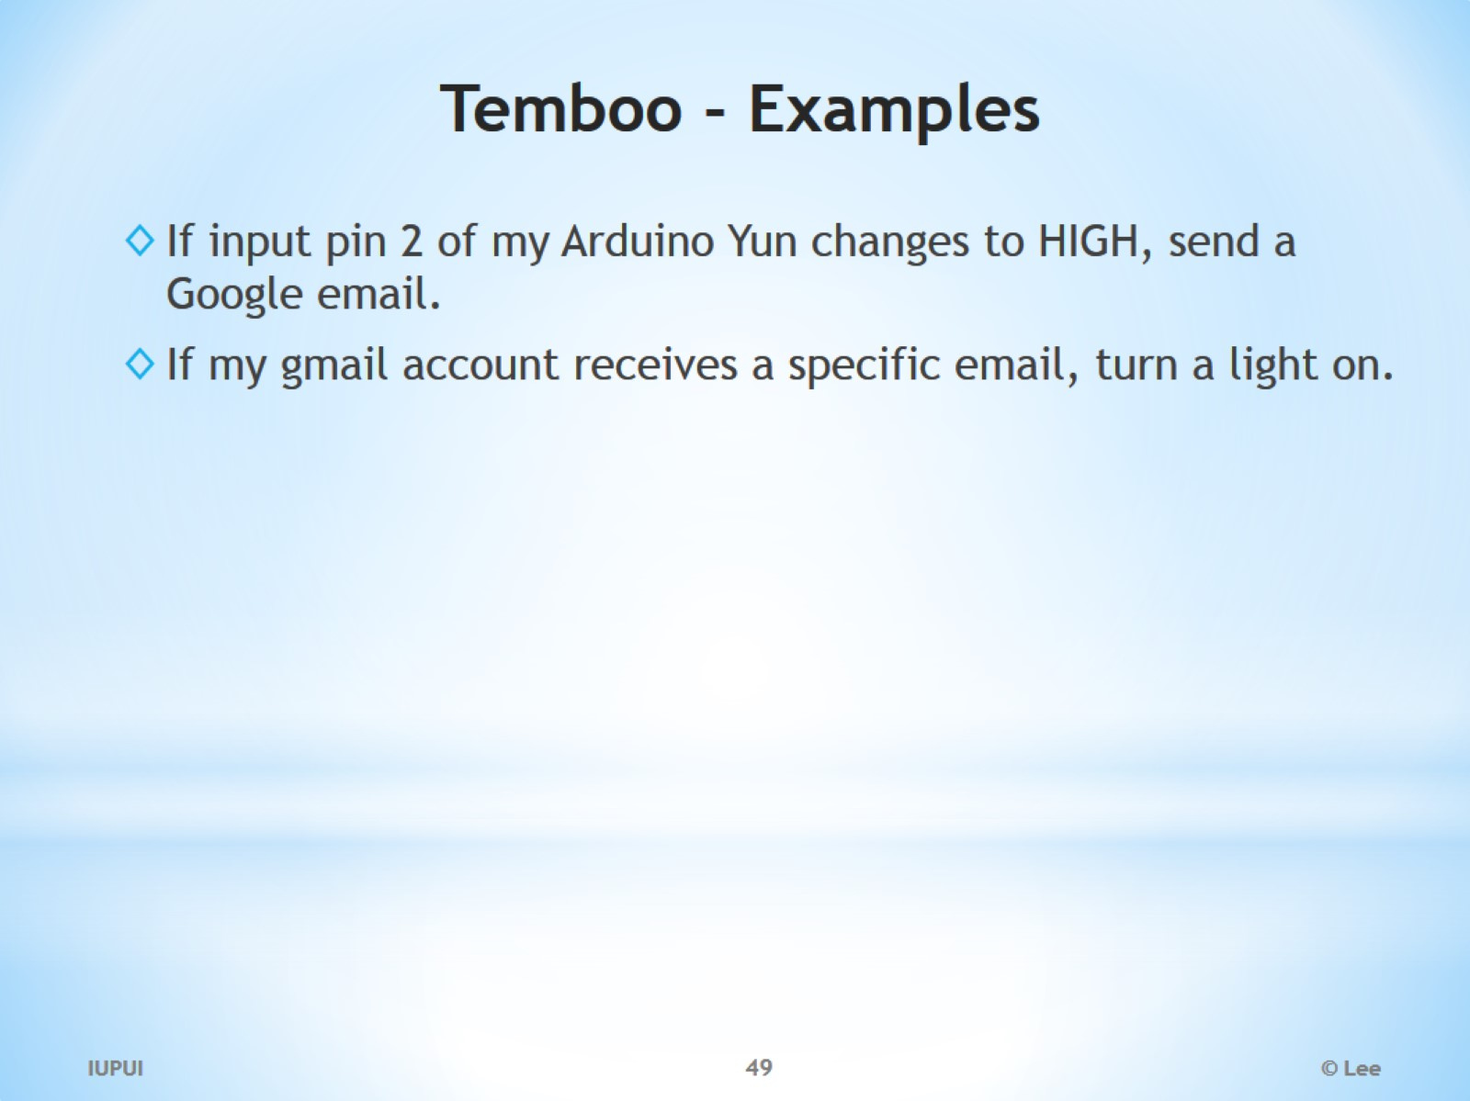
Temboo - Examples

Slide 50
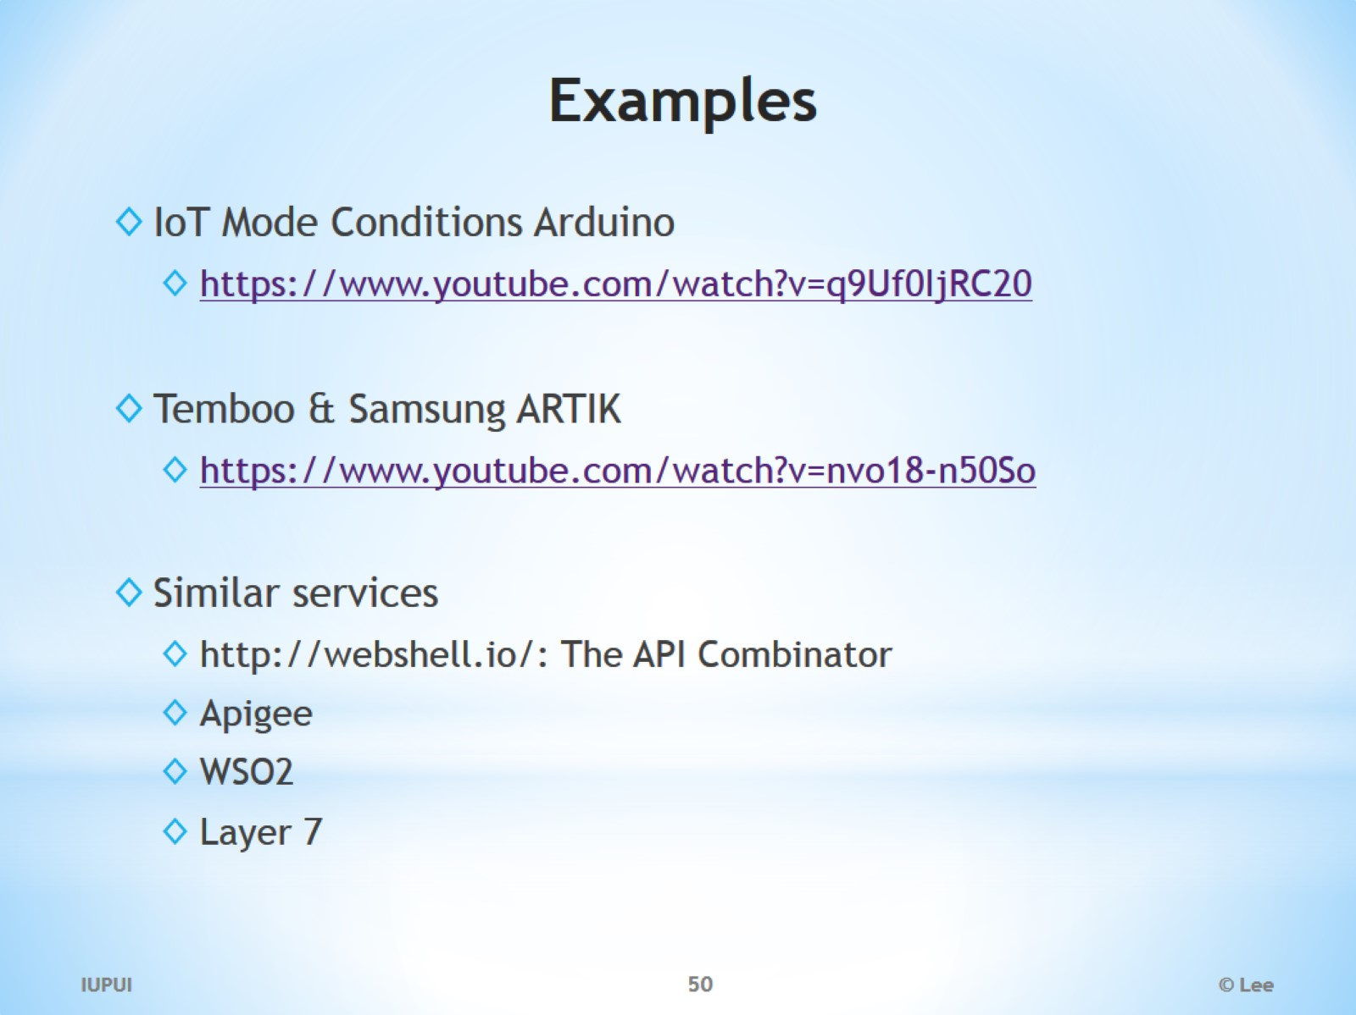
Examples

Slide 51
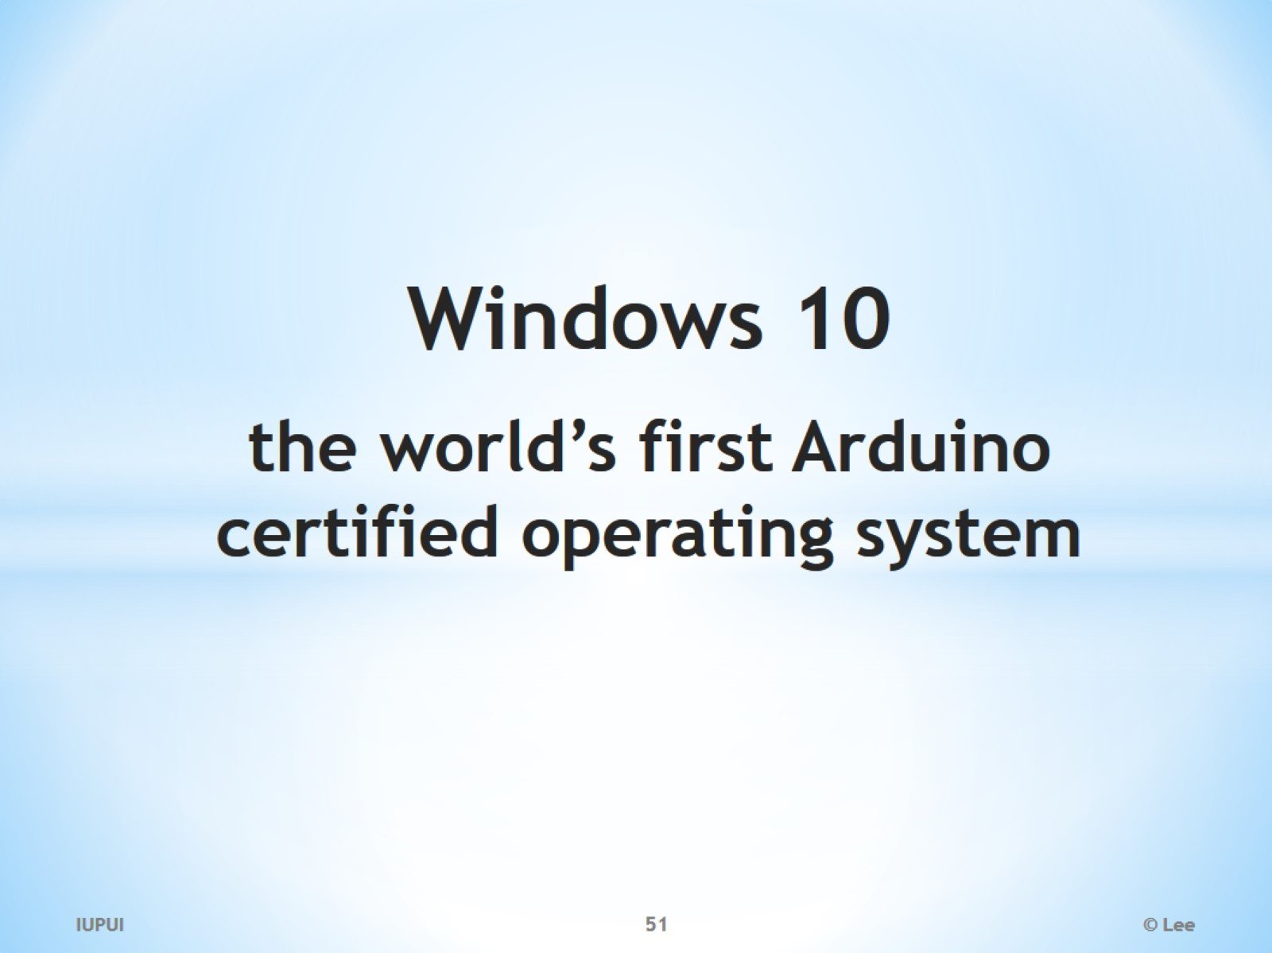
Windows 10 the world’s first Arduino certified operating system

Slide 52
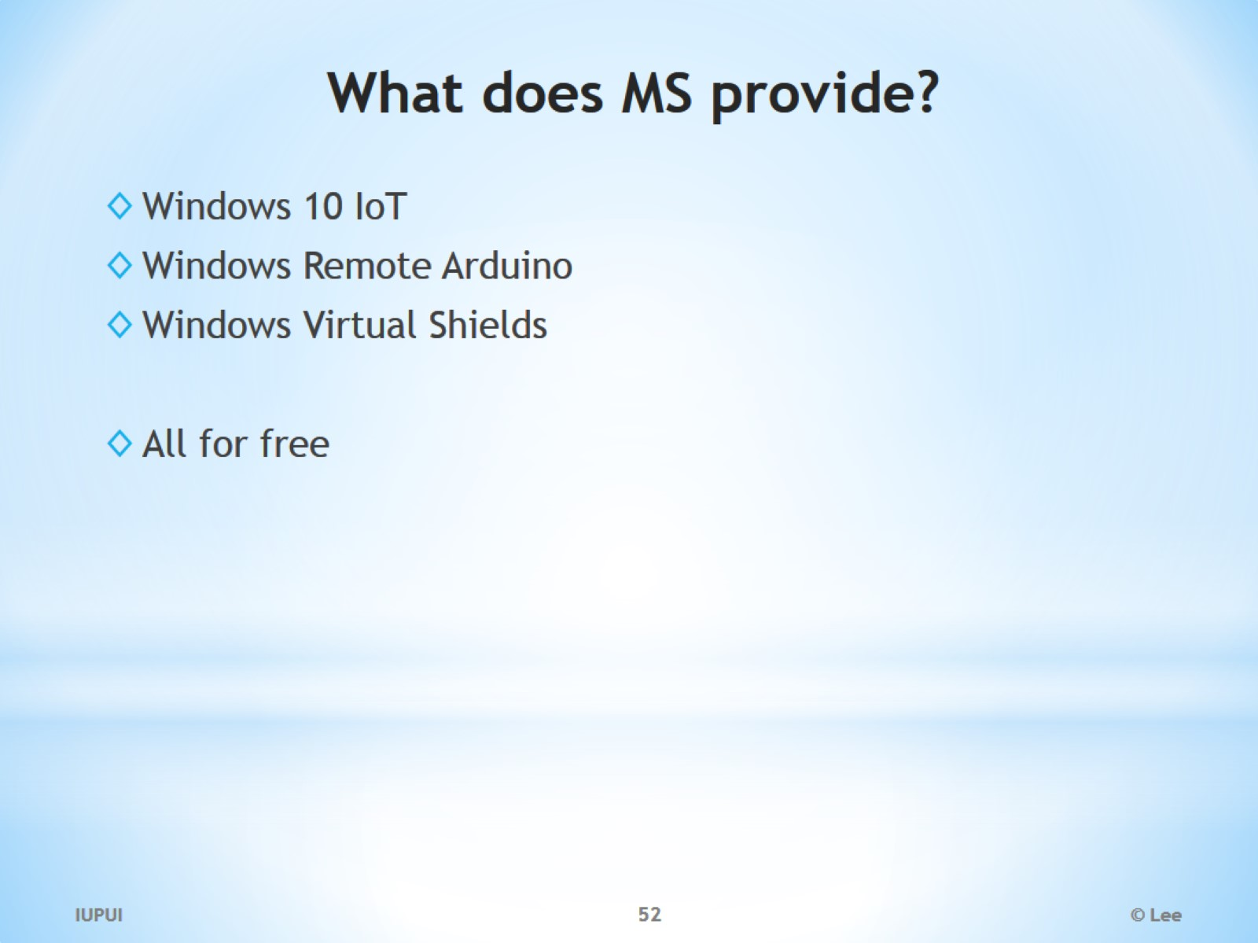
What does MS provide?

Slide 53

Why did Microsoft jumped into IoT business for free?

Slide 54
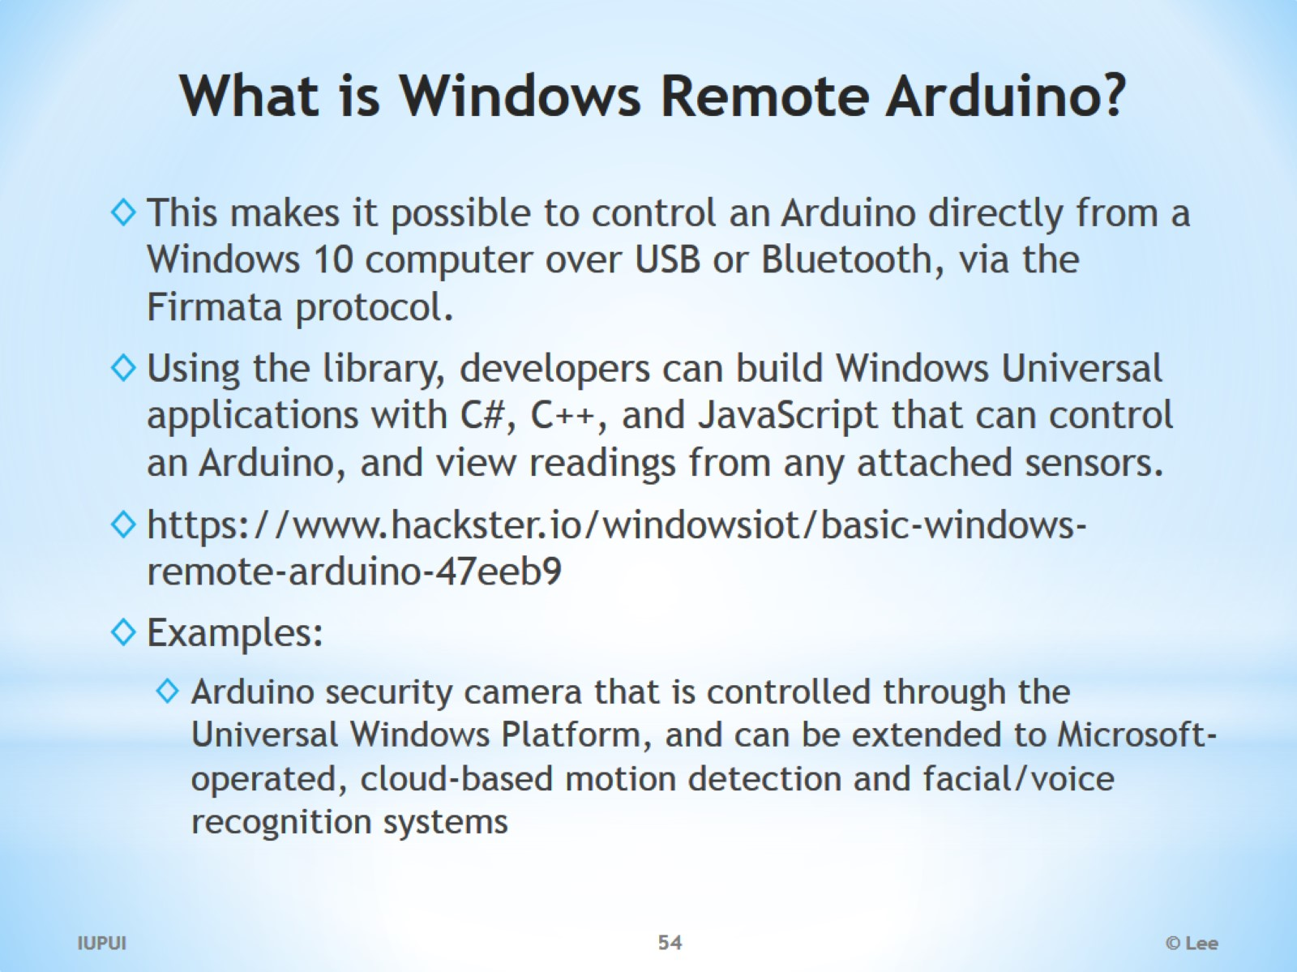
What is Windows Remote Arduino?

Slide 55

Windows Virtual Shields

Slide 56

Node-RED

Slide 57

SiteWhere

